Slide 1

Viskit: Visual Simkit Editor
Don Brutzman and Terry Norbraten
Modeling Virtual Environments Simulation (MOVES) Institute
Naval Postgraduate School (NPS)
13 May 2025

Slide 2
Overview
Viskit is an open-source application for defining Discrete Event Simulation (DES) models that autogenerate Java source using the Simkit library.
The Viskit application allows you to build a collection of event graphs that describe the behavior of various entities in a simulation environment.
Capabilities include Simkit Event Graphs, Assemblies, simulation tools, and an Analyst Report generator suitable for thesis and research efforts.
The current release includes a thorough refactoring of the underlying Viskit source code, facilitating ongoing maintenance and development.
Efforts are ongoing.

Slide 3
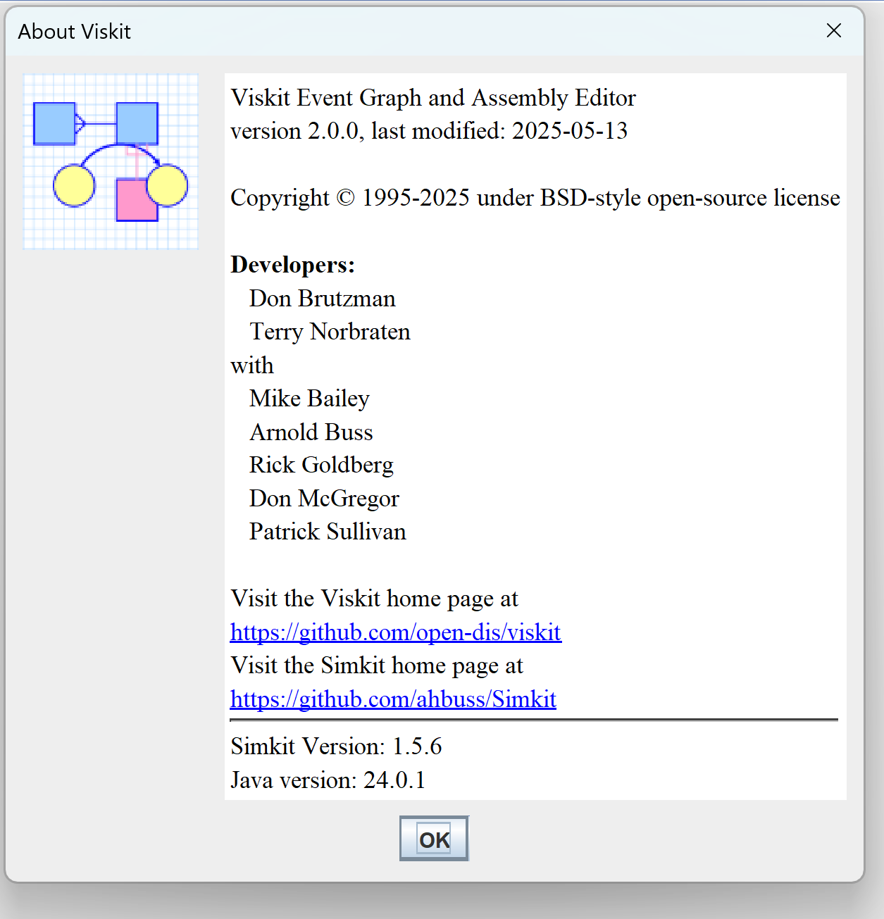
About

Slide 4
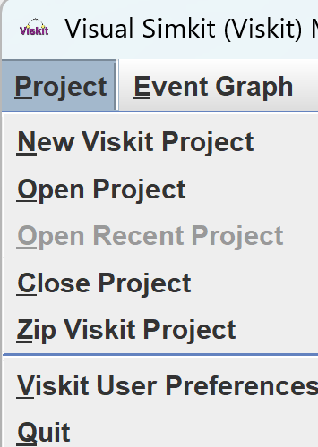
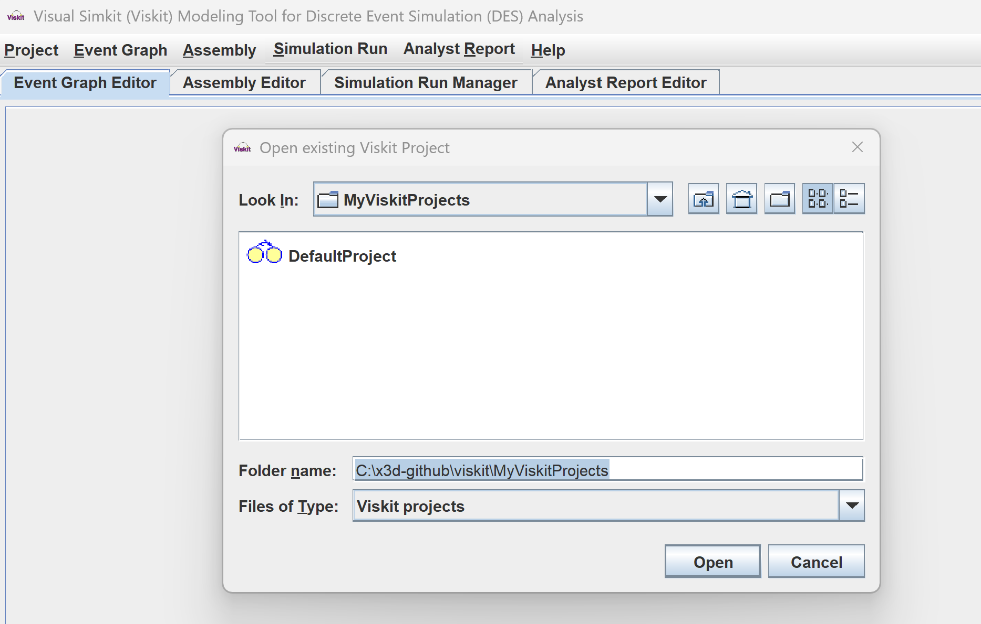
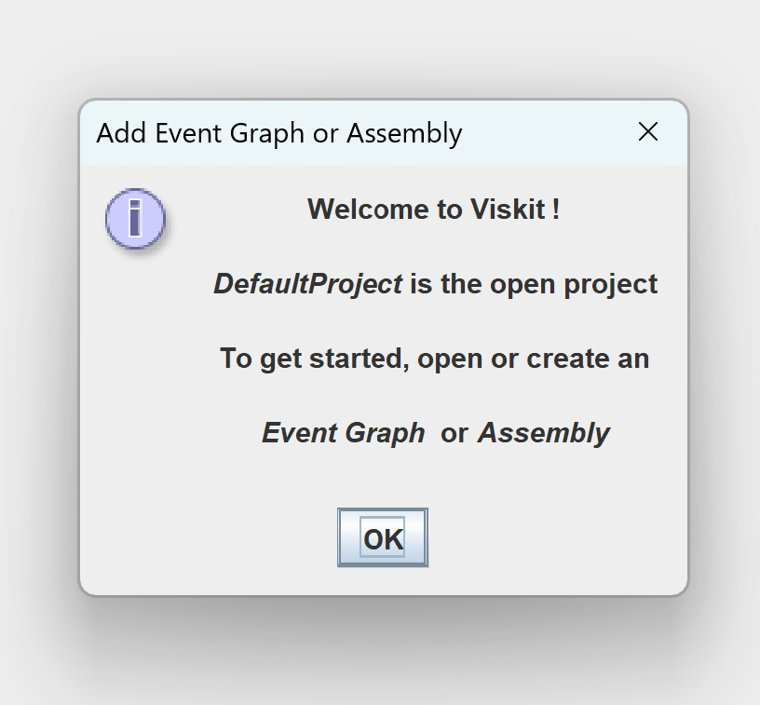
Viskit is organized according to Viskit Projects

Slide 5
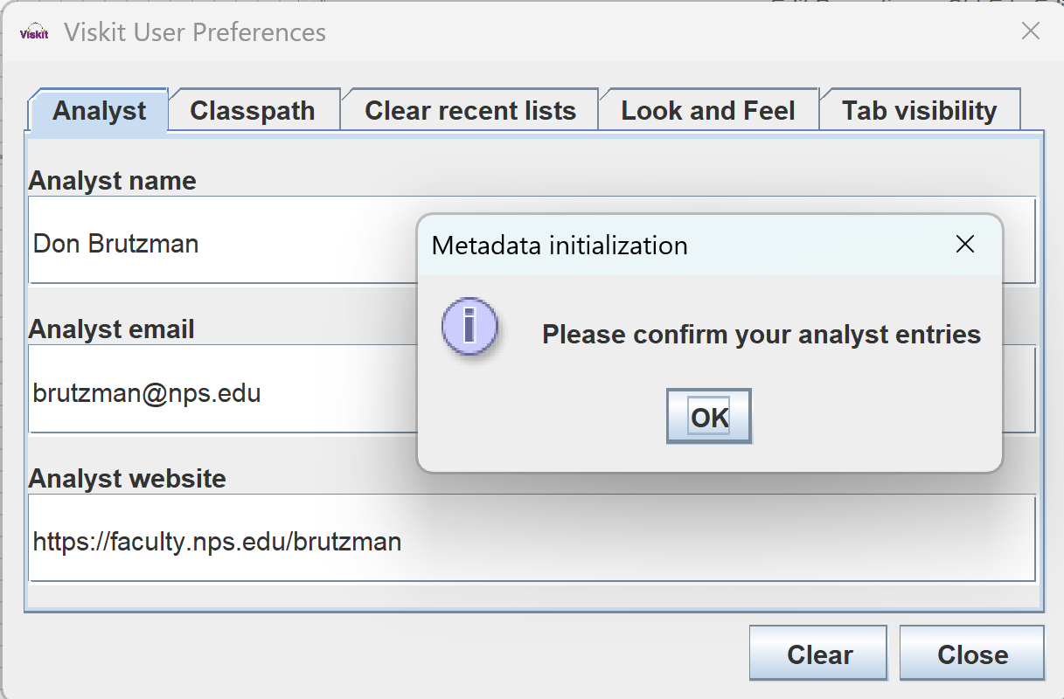
Viskit User Preferences
User information is applied when creating an Analyst Report

Slide 6
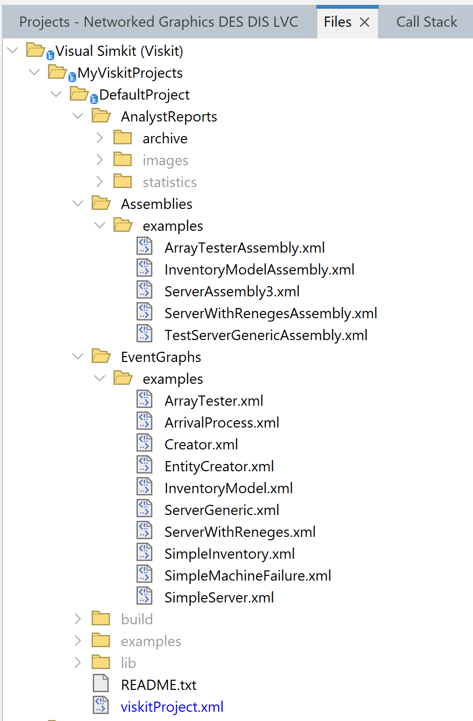
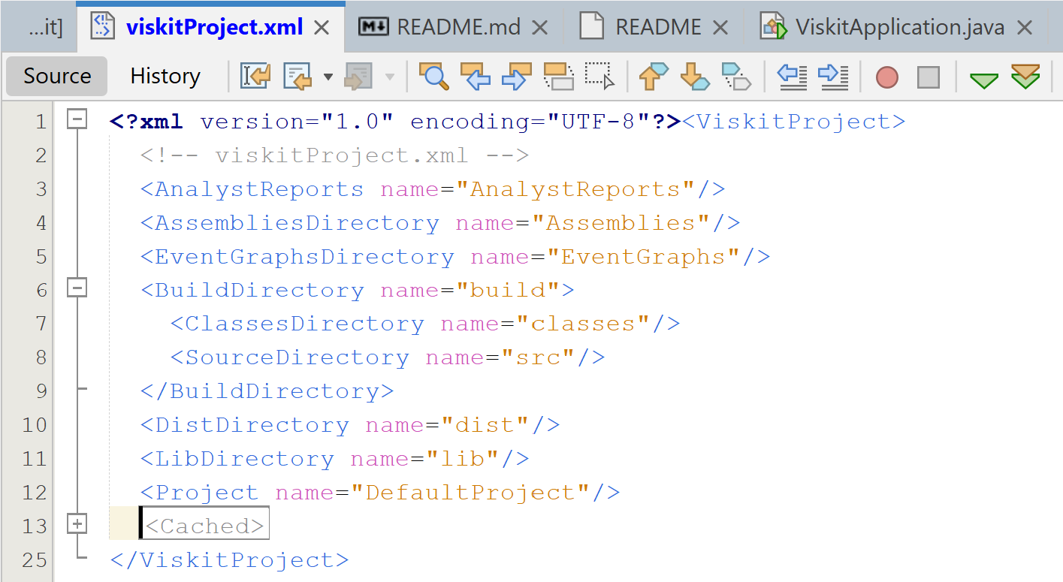
Viskit project files contain multiple assets

Slide 7
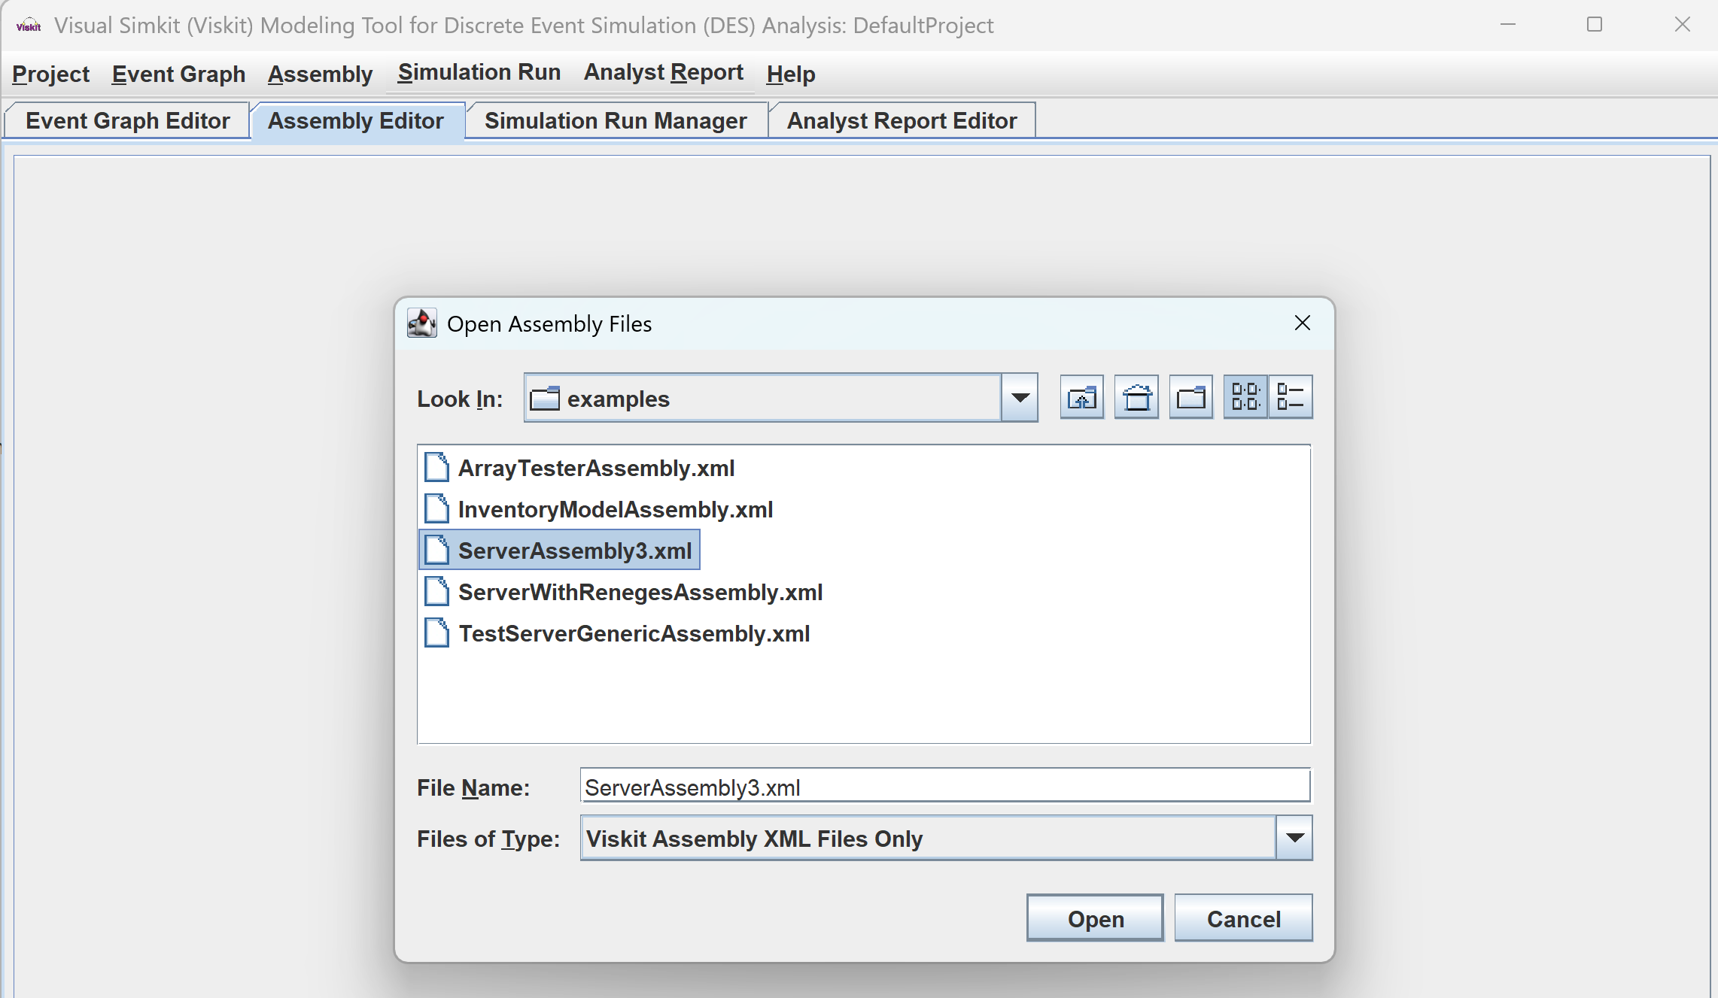
Next step: open an assembly

Slide 8
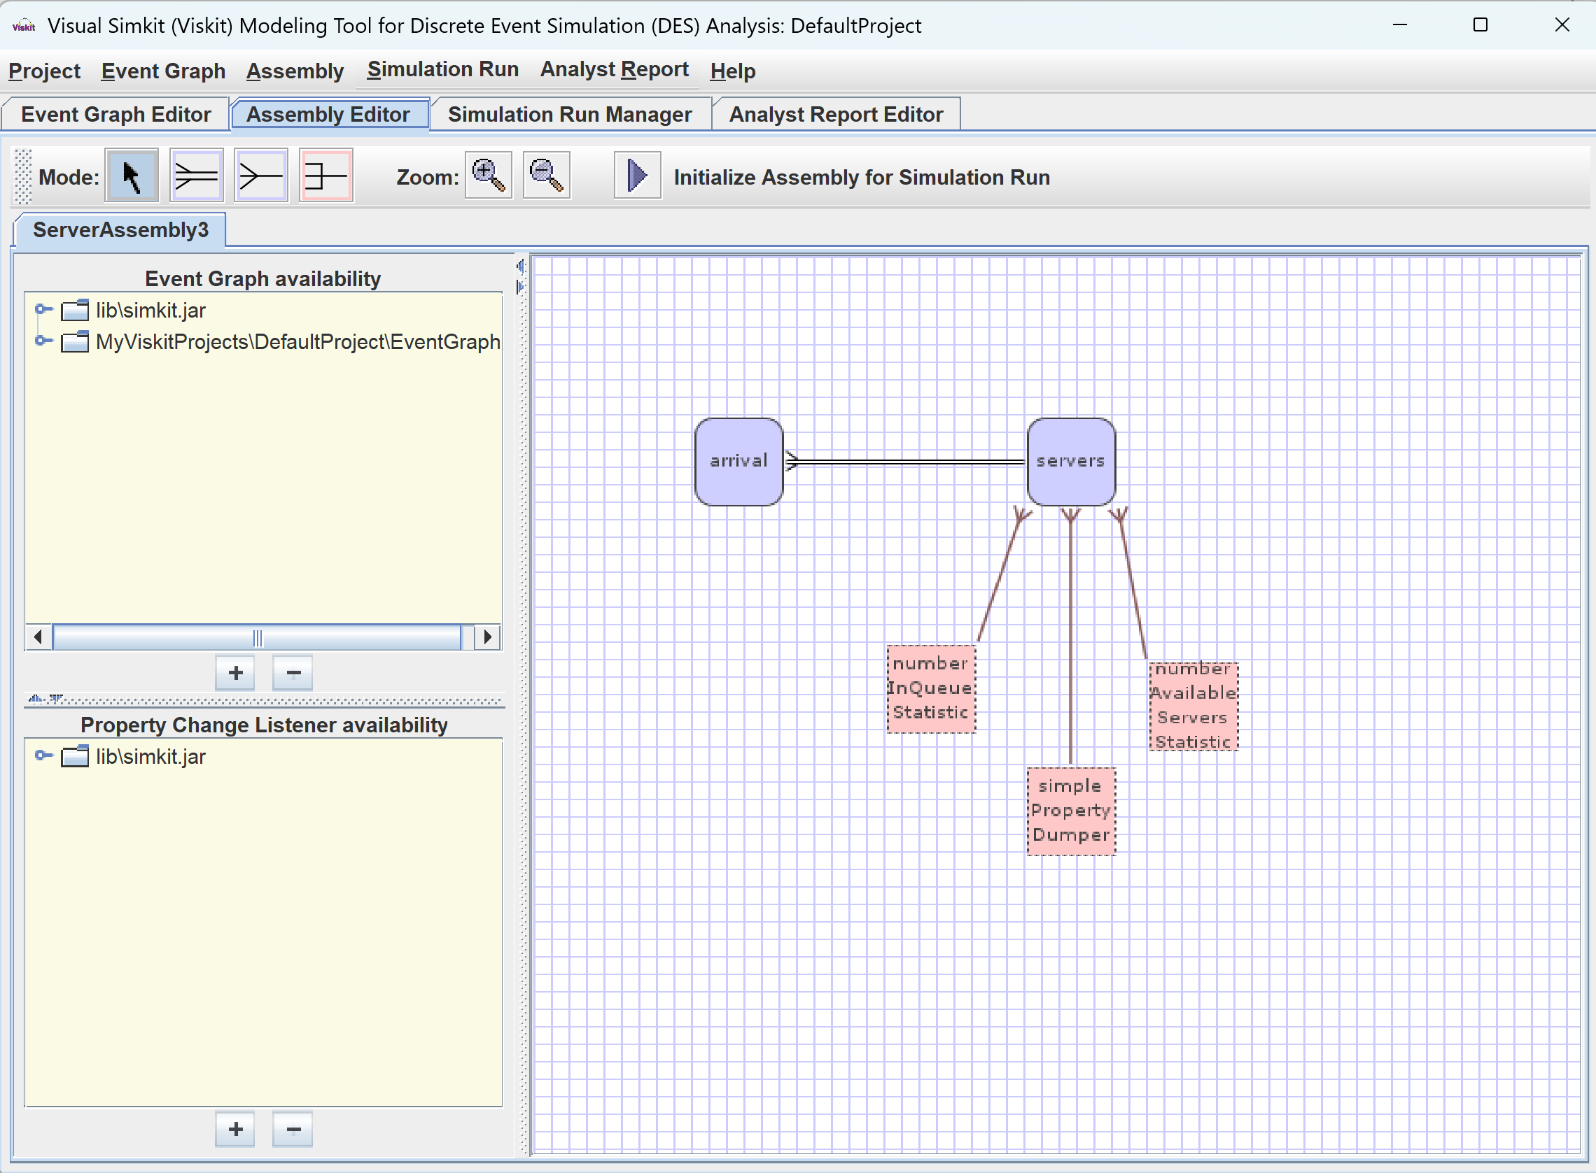
For example Server Assembly3 .xml

Slide 9
Editing

Slide 10
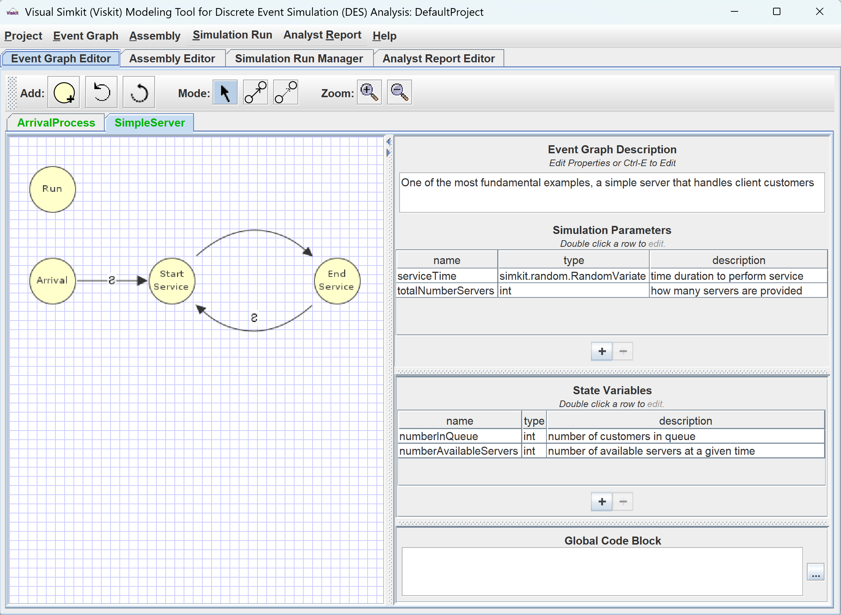
Check that corresponding Event Graphs were opened
Check out
Event Graphs
Simulation Parameters and State Variables

Slide 11
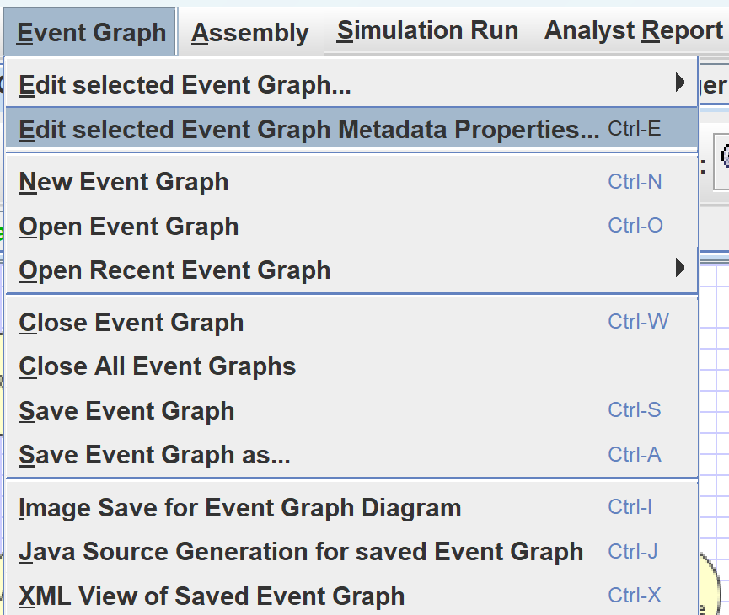
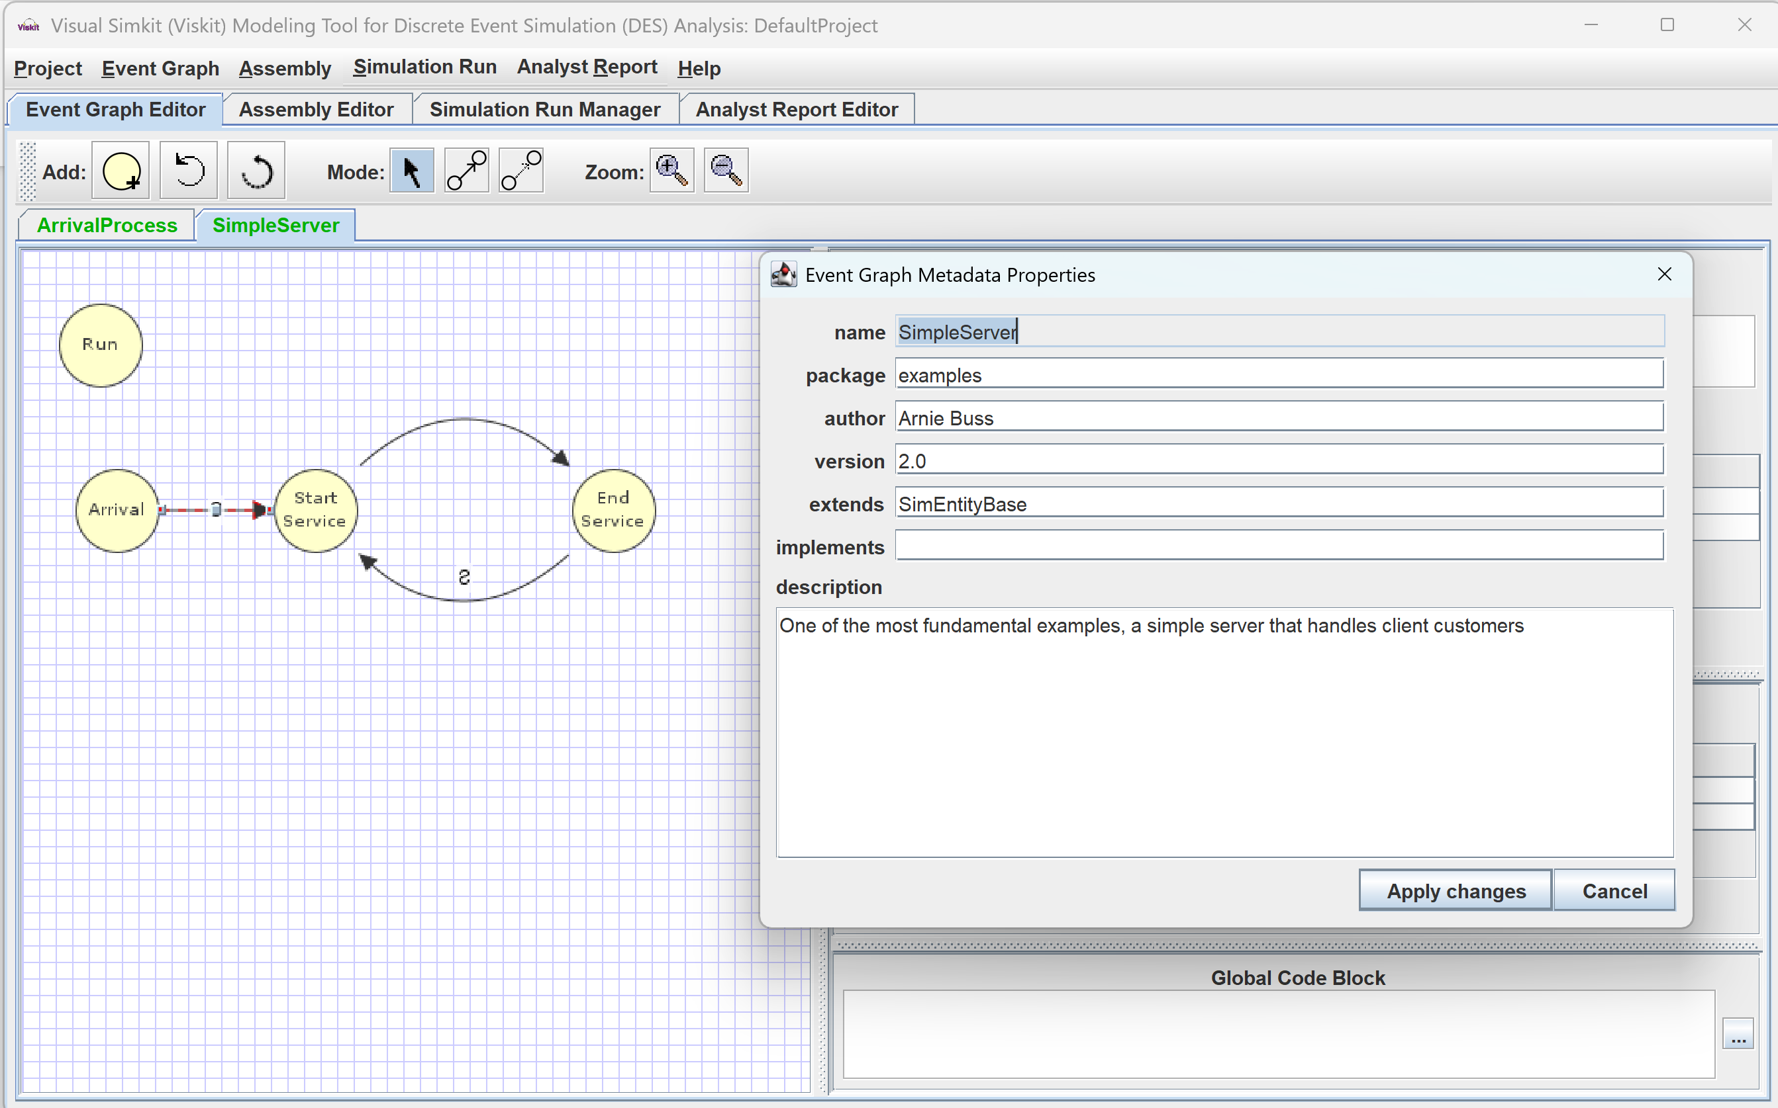
Editing an Event Graph Inspect Metadata

Slide 12
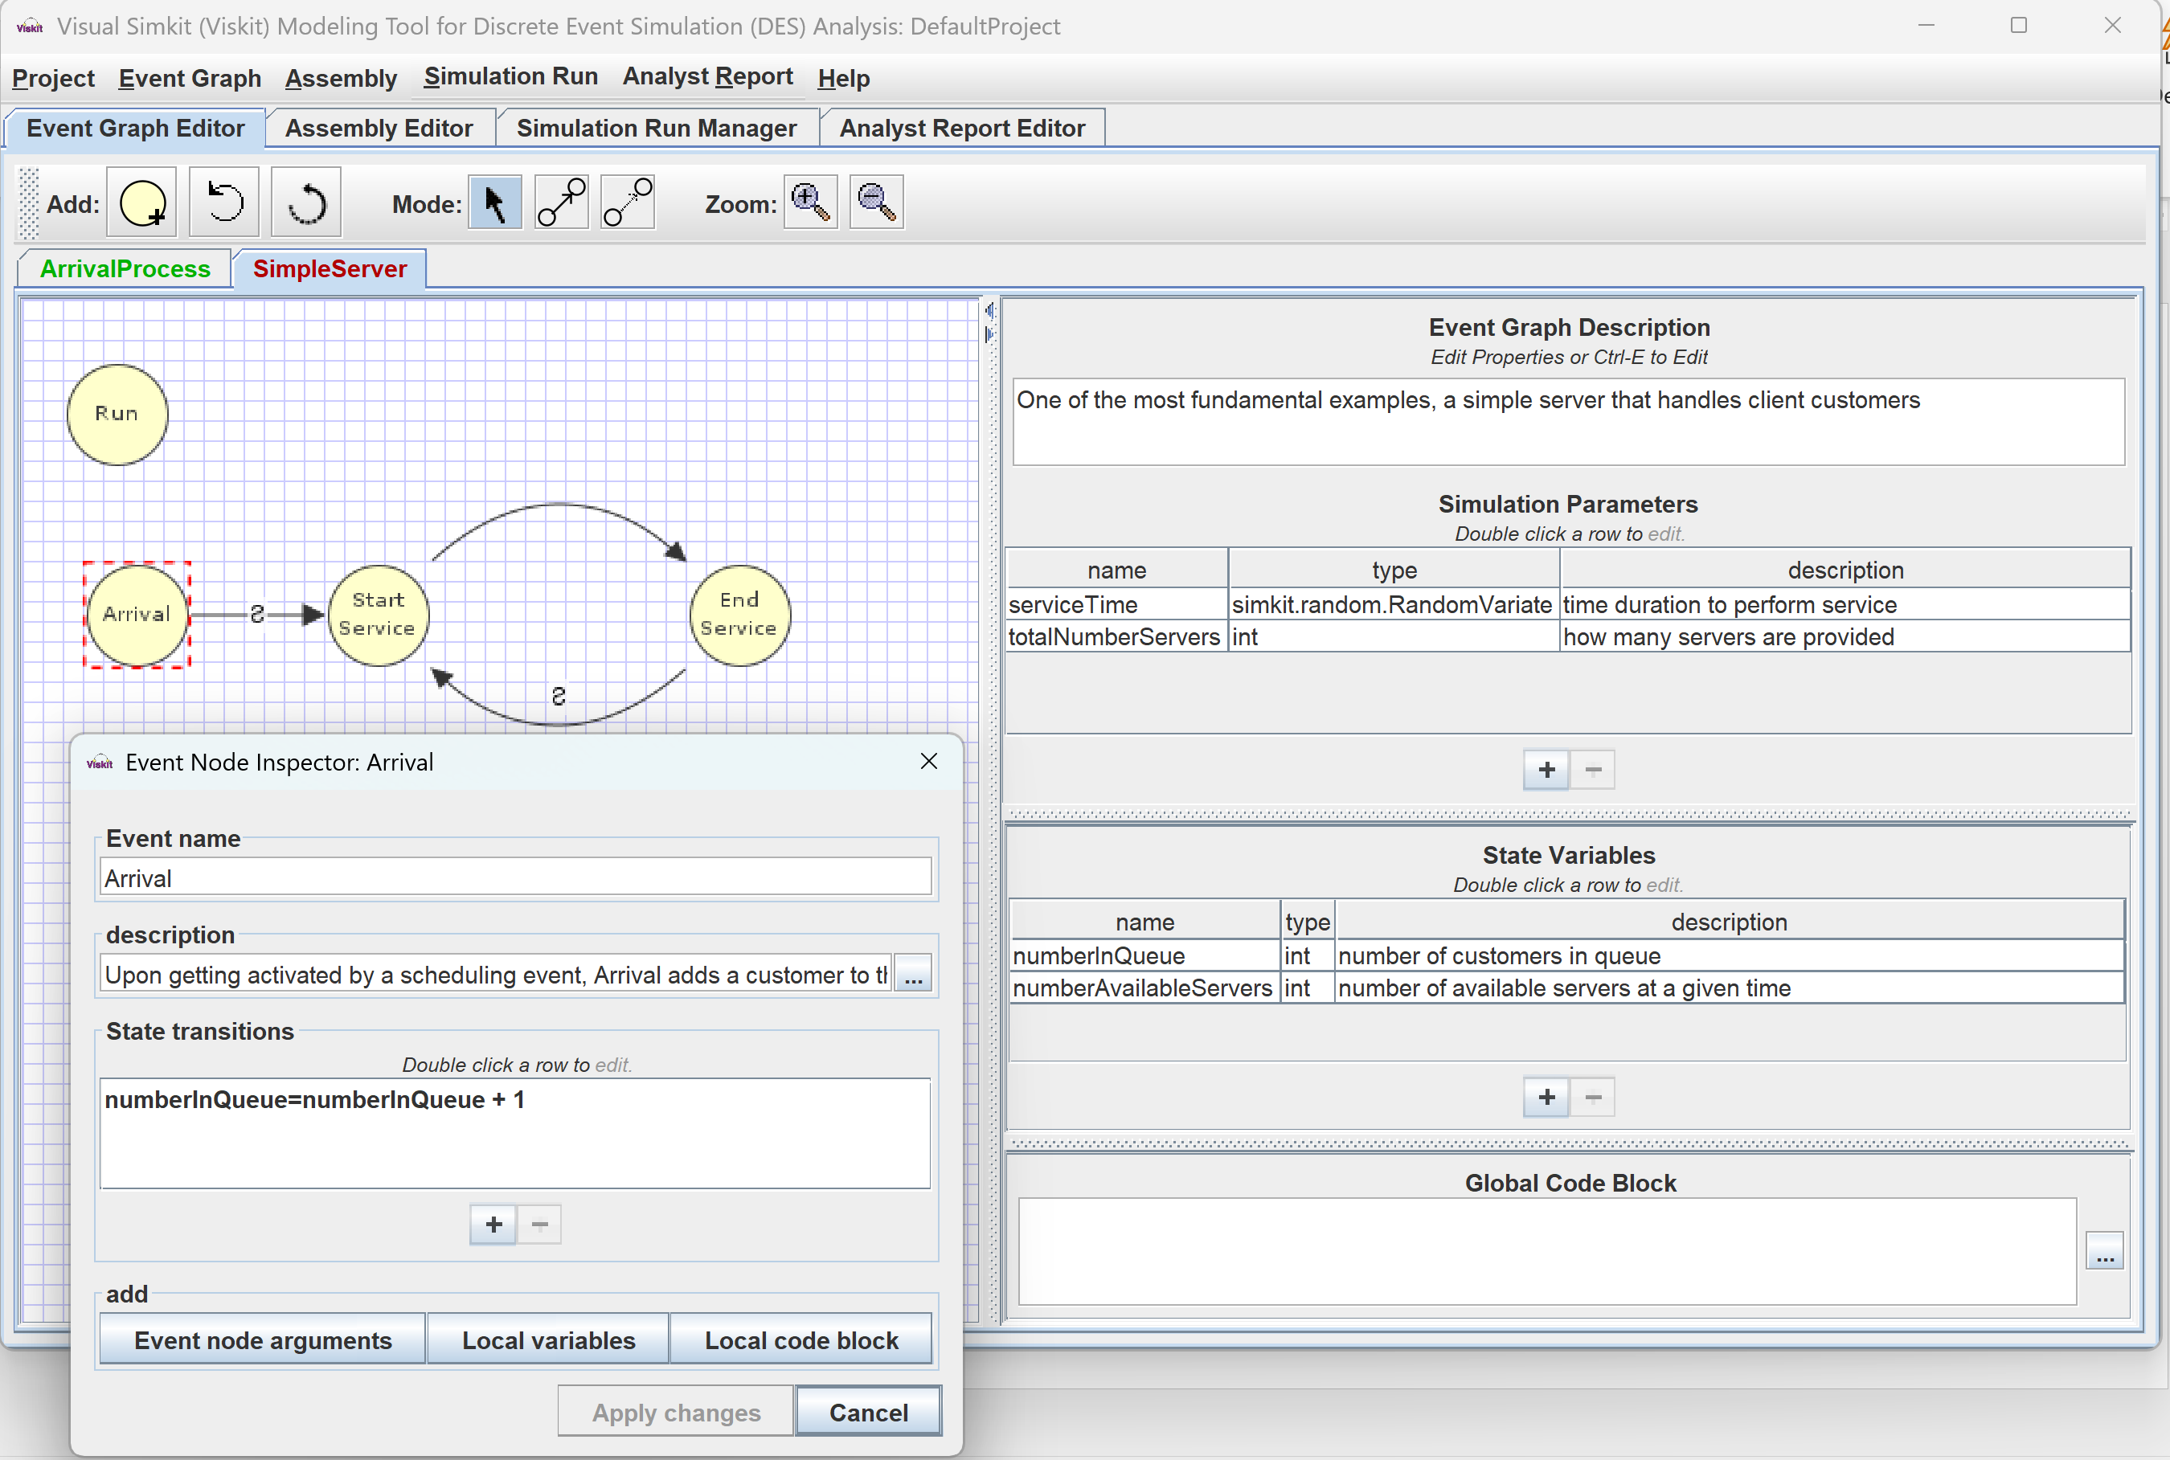
Editing an Event Graph Inspect State Nodes

Slide 13
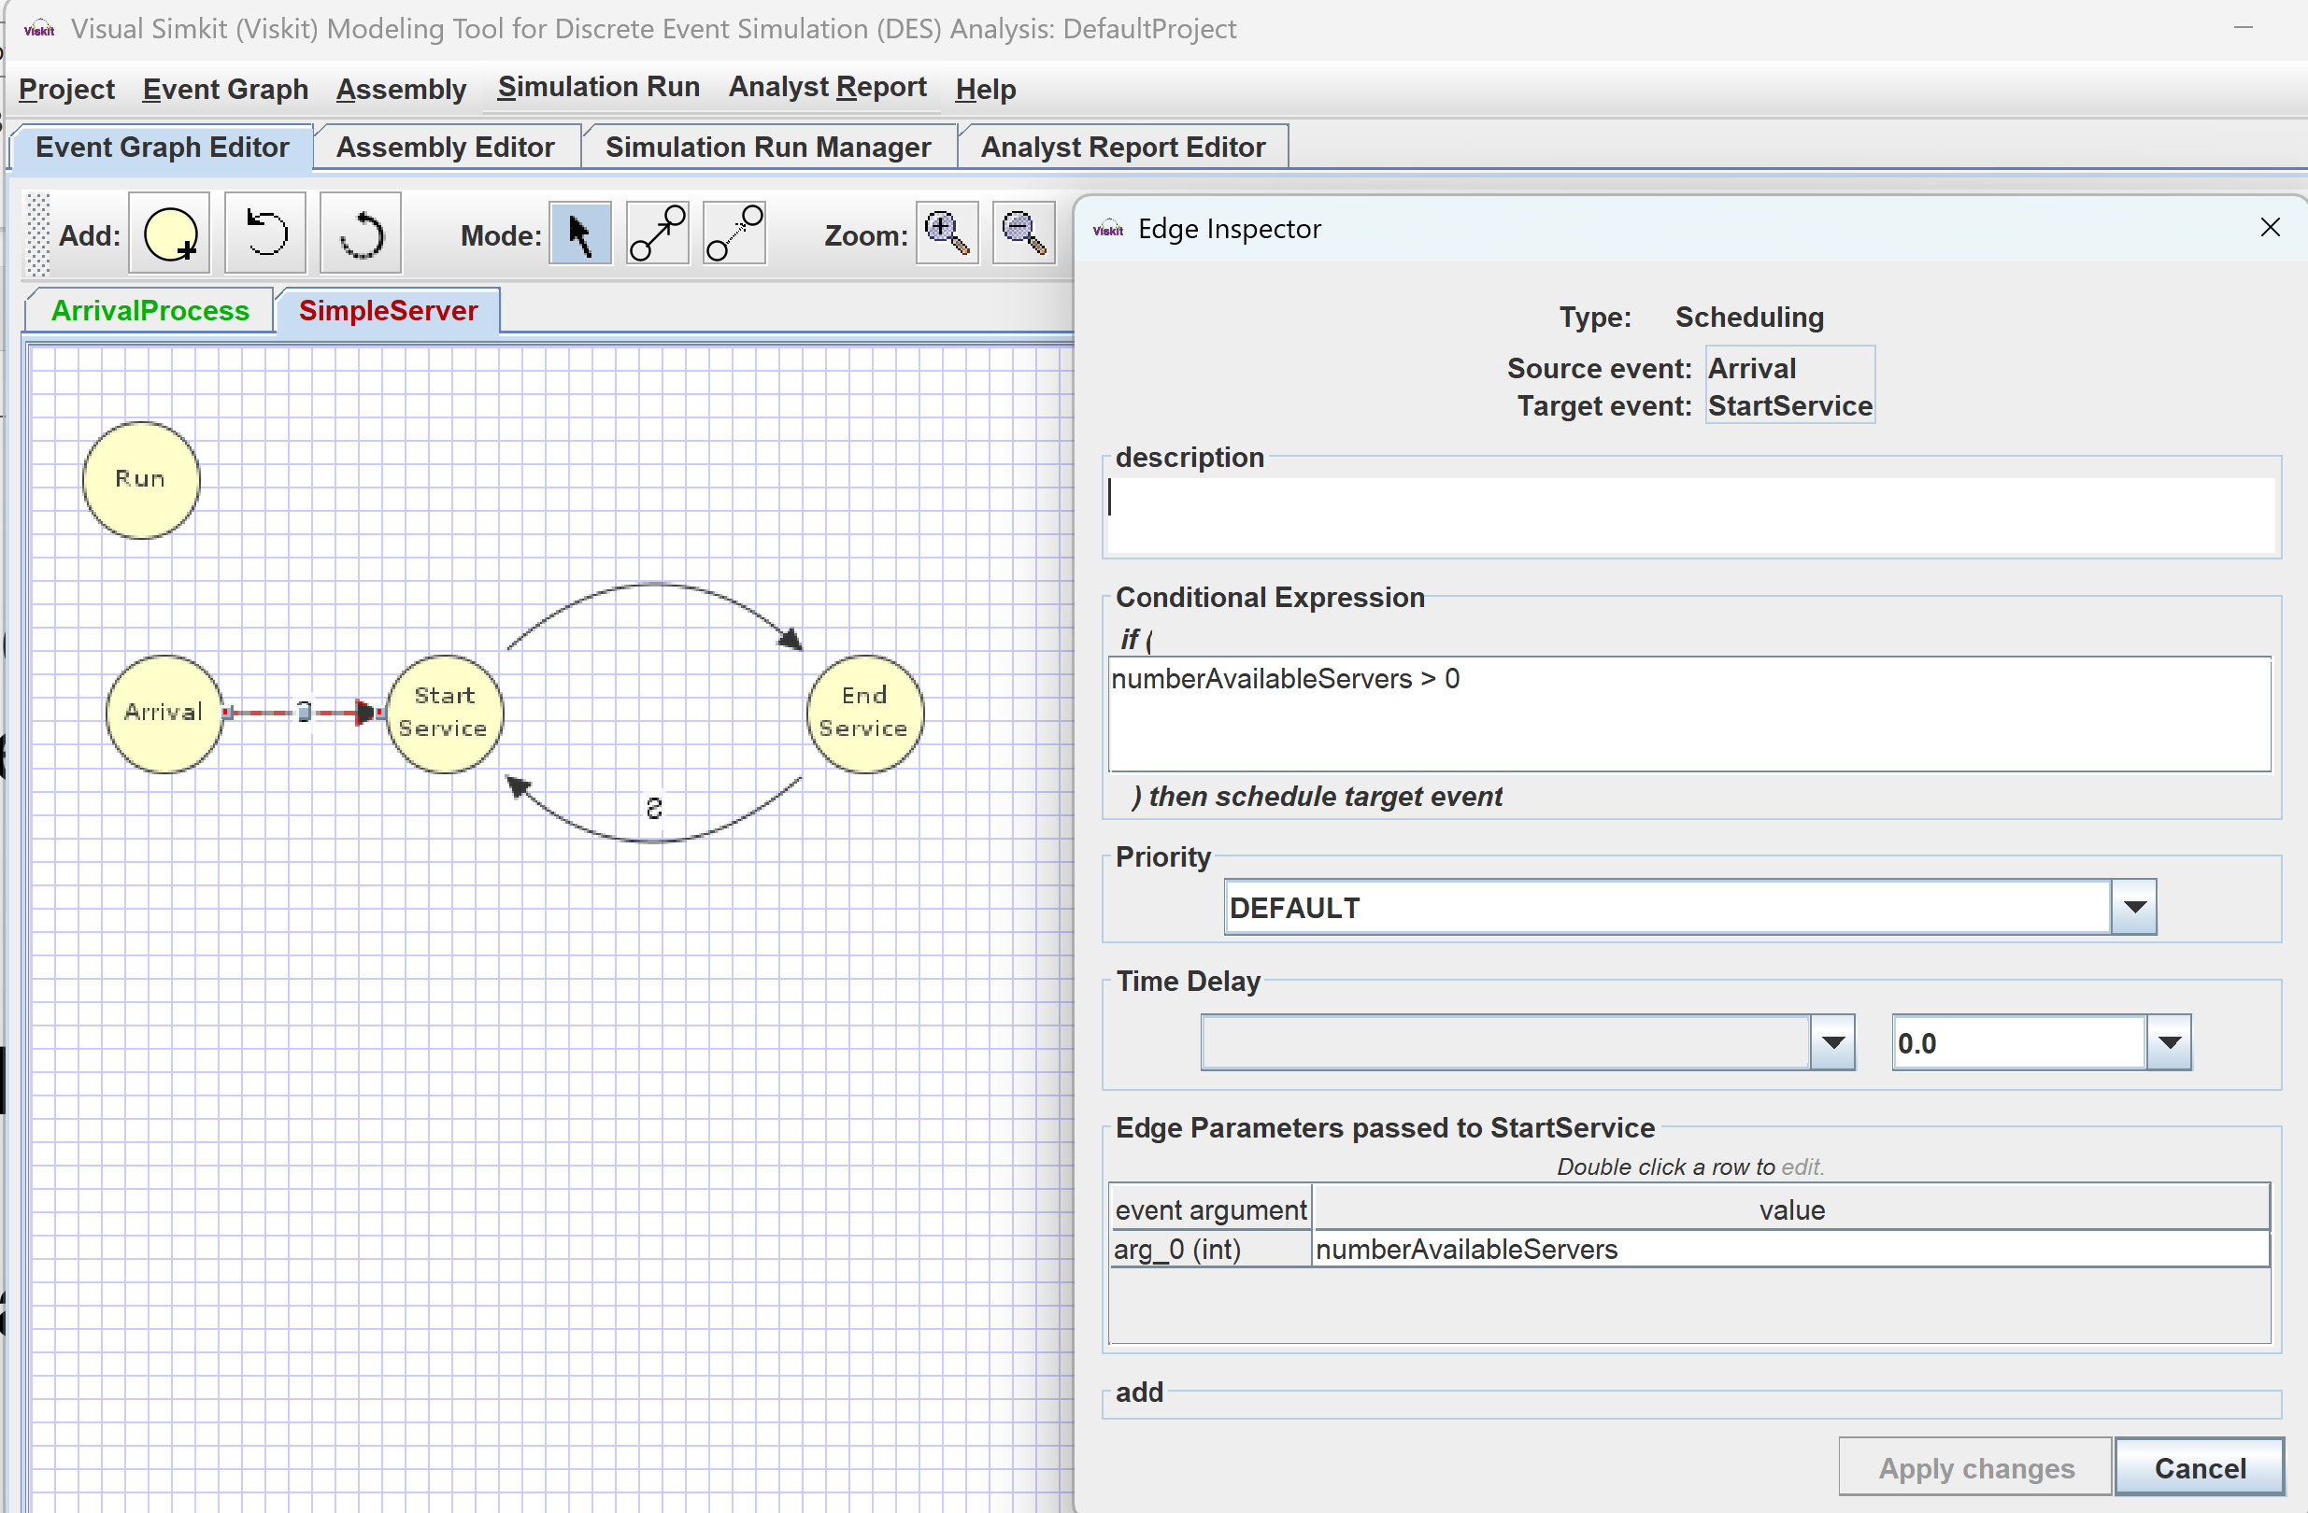
Editing an Event Graph Inspect Scheduling (Cancelling) Edge Transitions

Slide 14
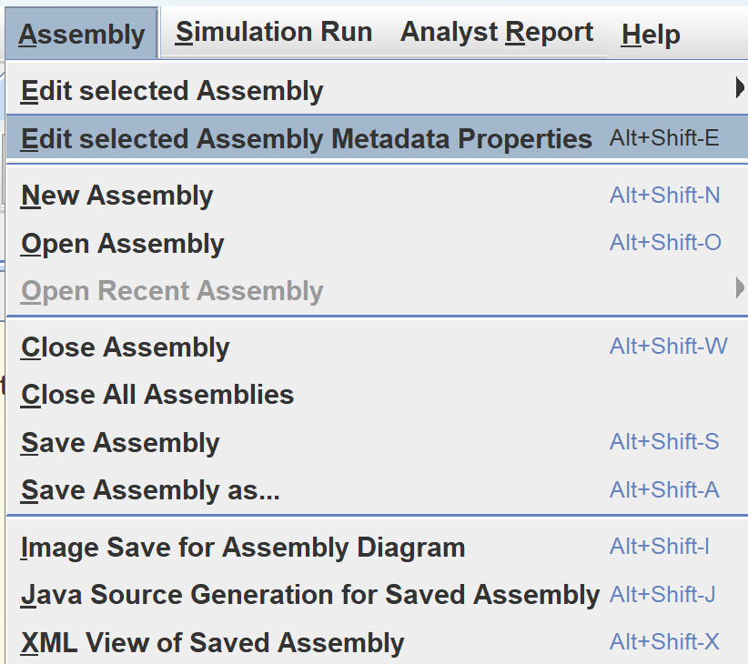
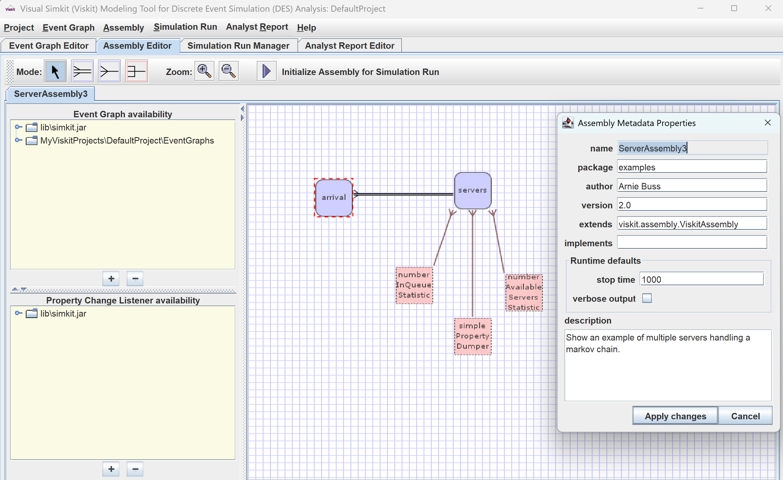
Editing an assembly Inspect Metadata

Slide 15
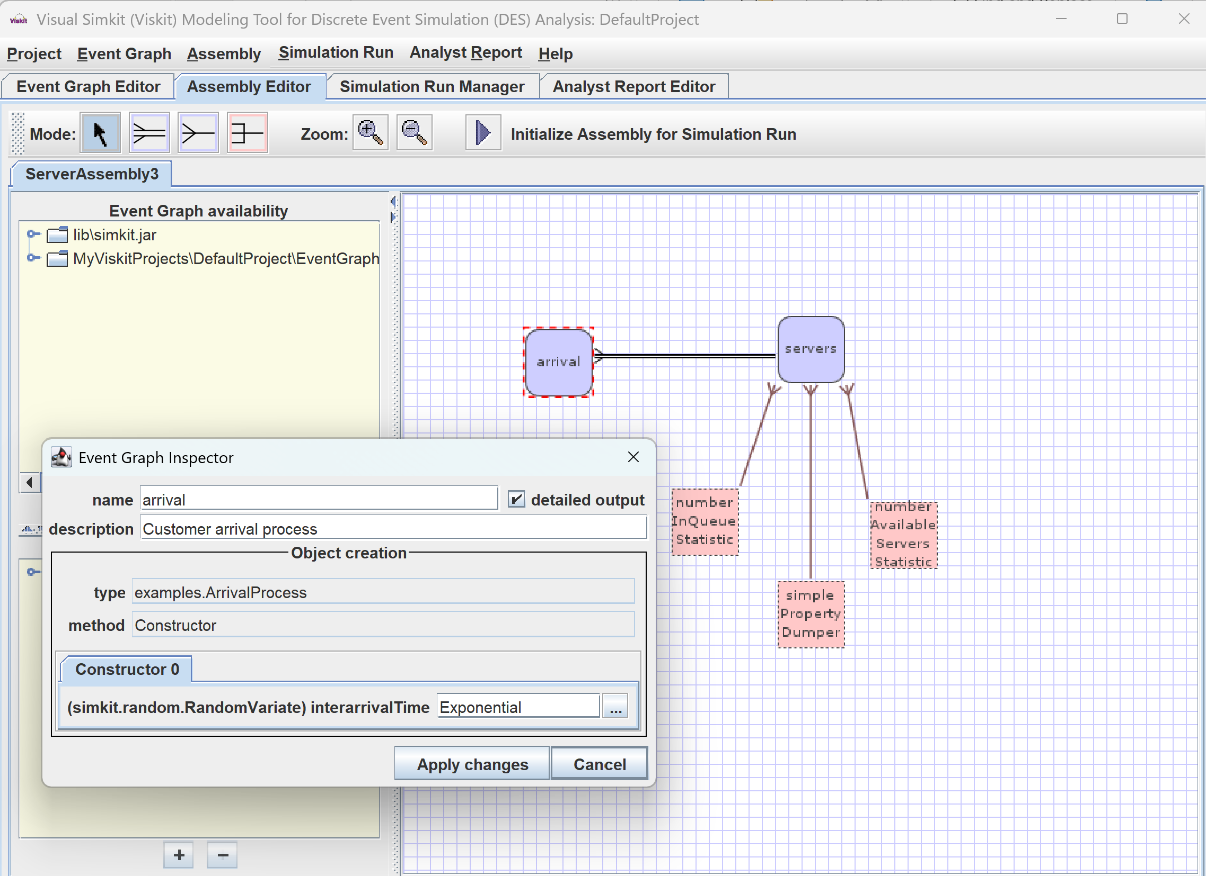
Editing an assembly Inspect Event Graph nodes

Slide 16
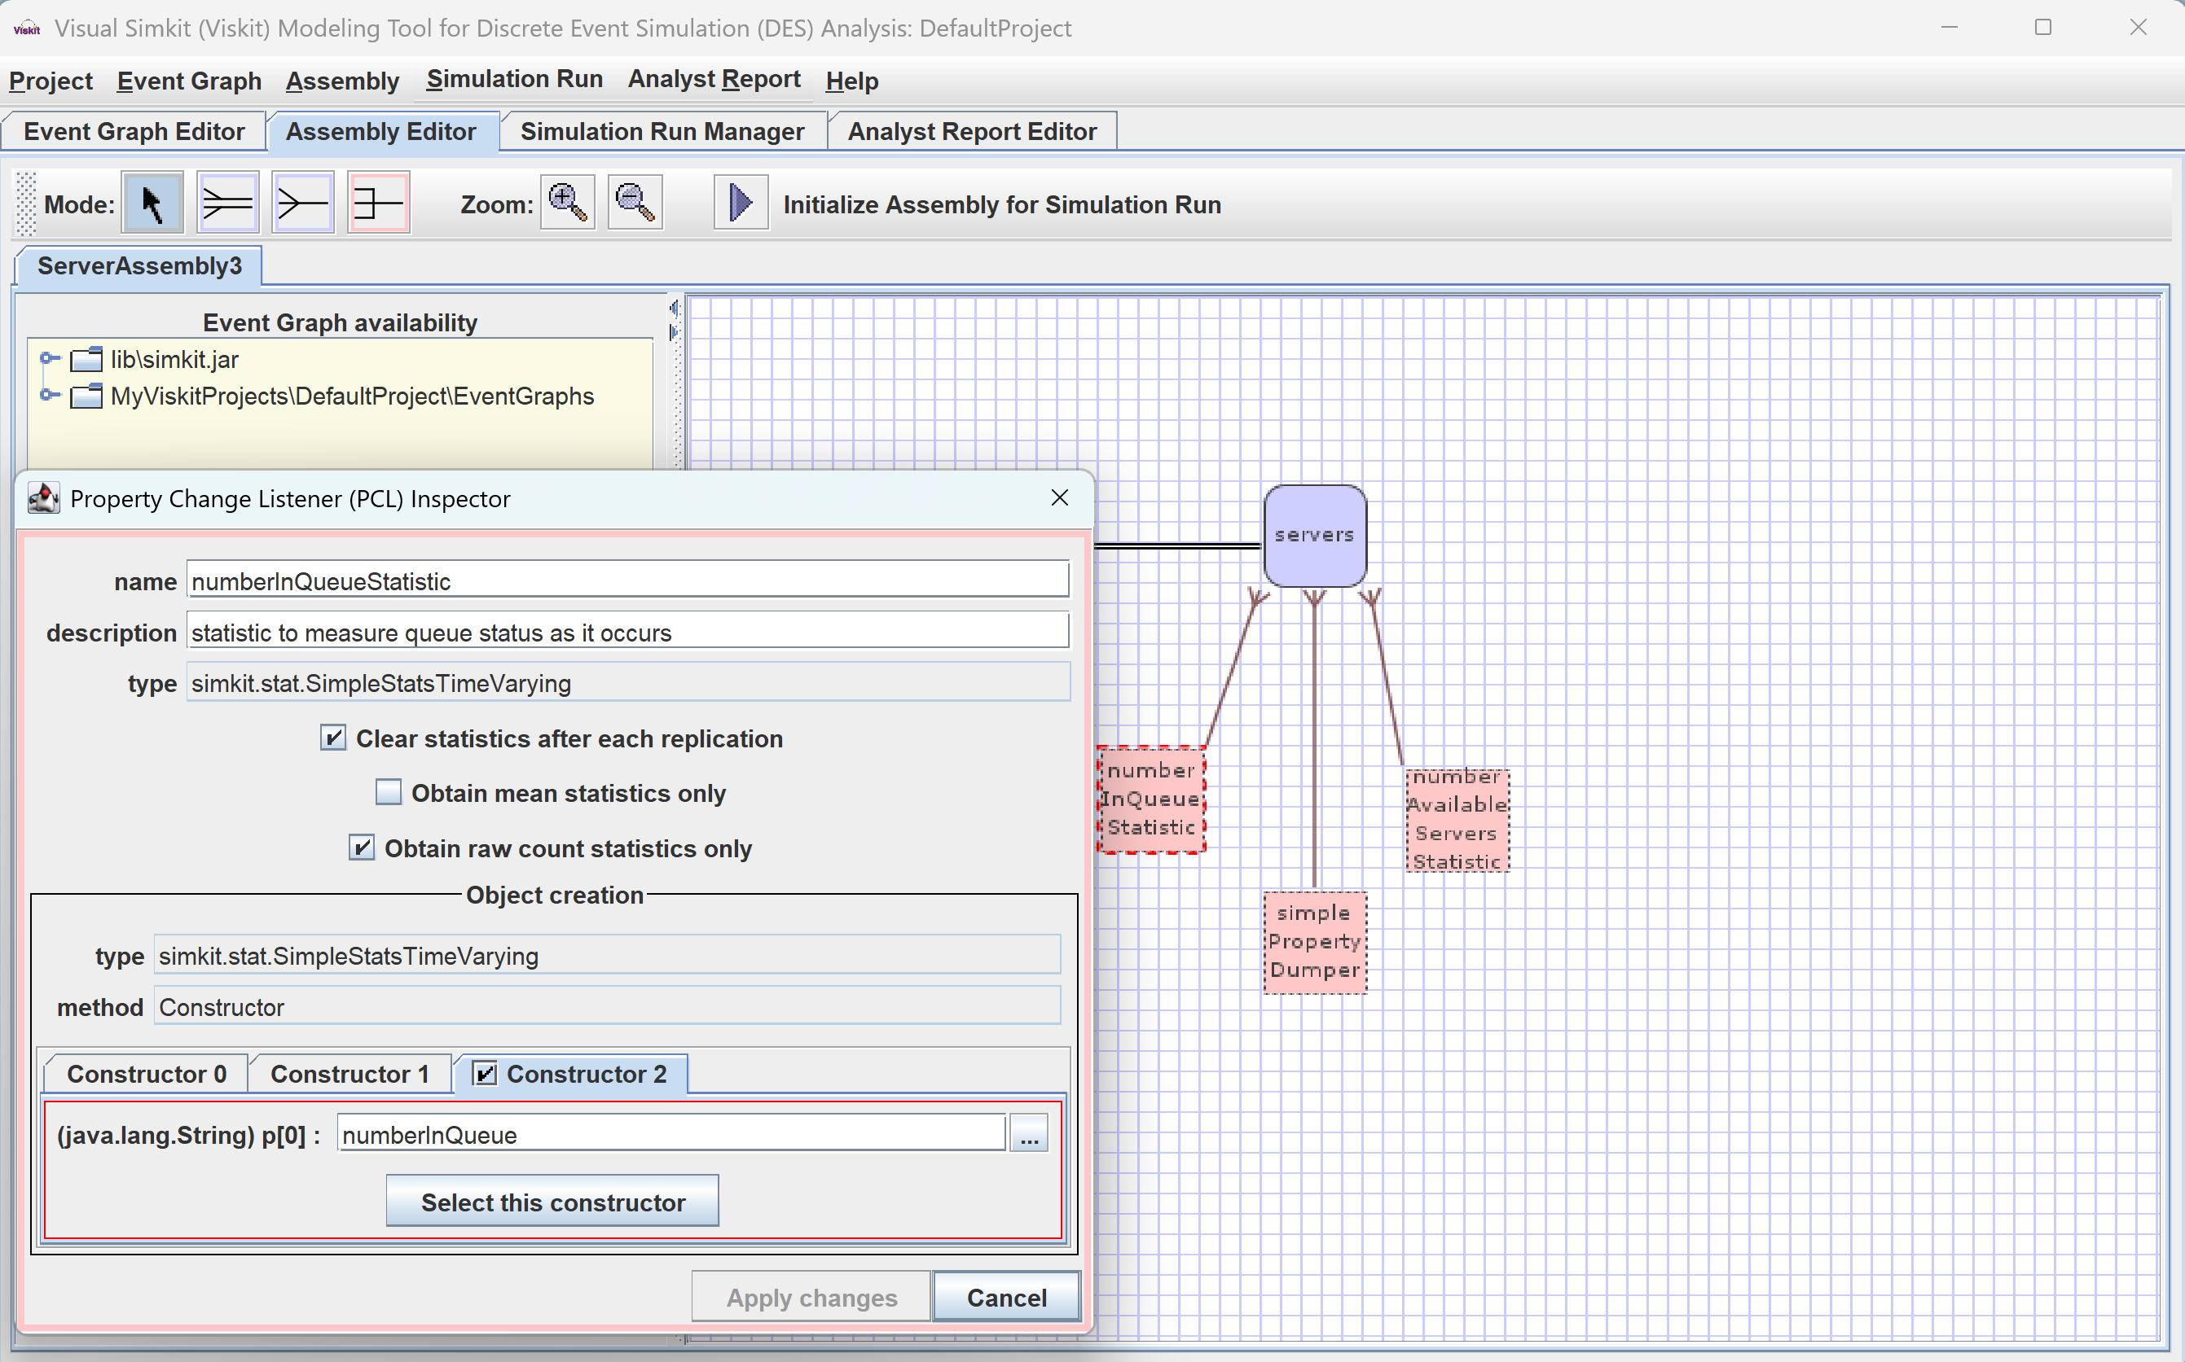
Editing an assembly Inspect Property Change Listeners PCLs

Slide 17
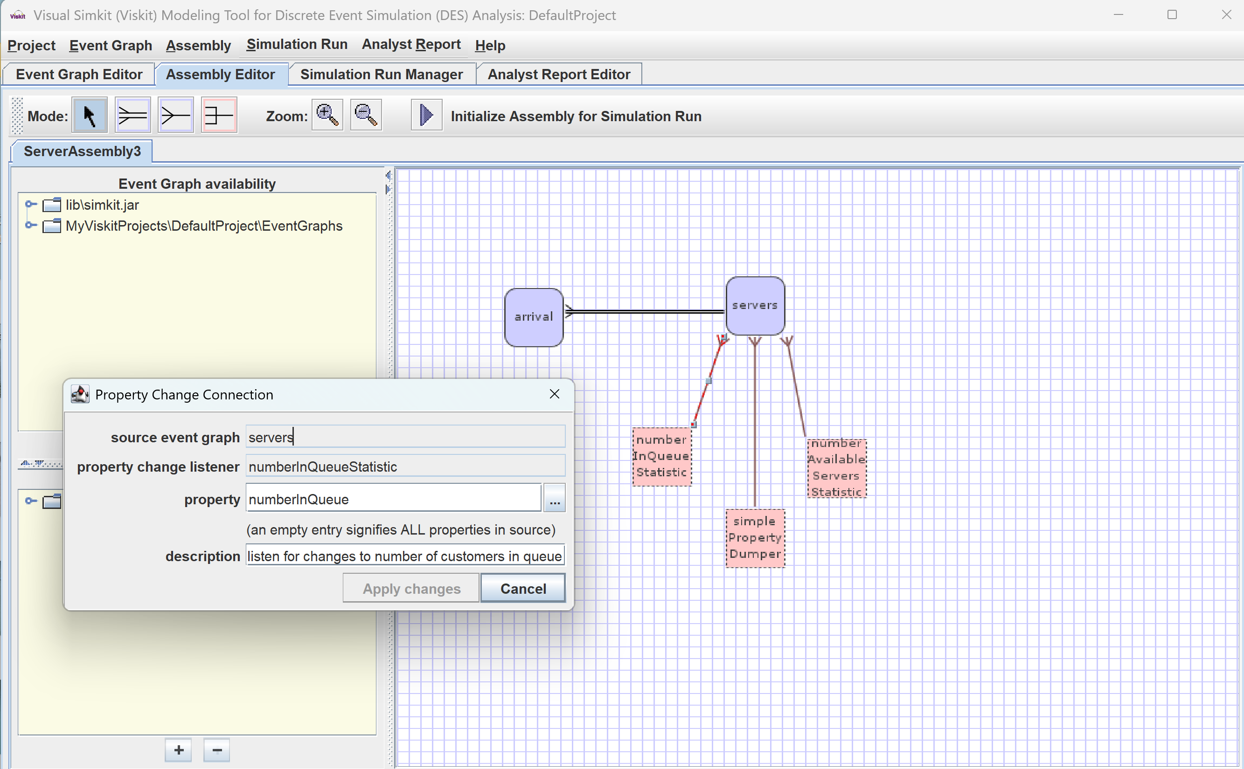
Editing an assembly Inspect Property Change Connection

Slide 18
Run Simulation Replications
Rehearse and repeat for several or numerous repetitions

Slide 19
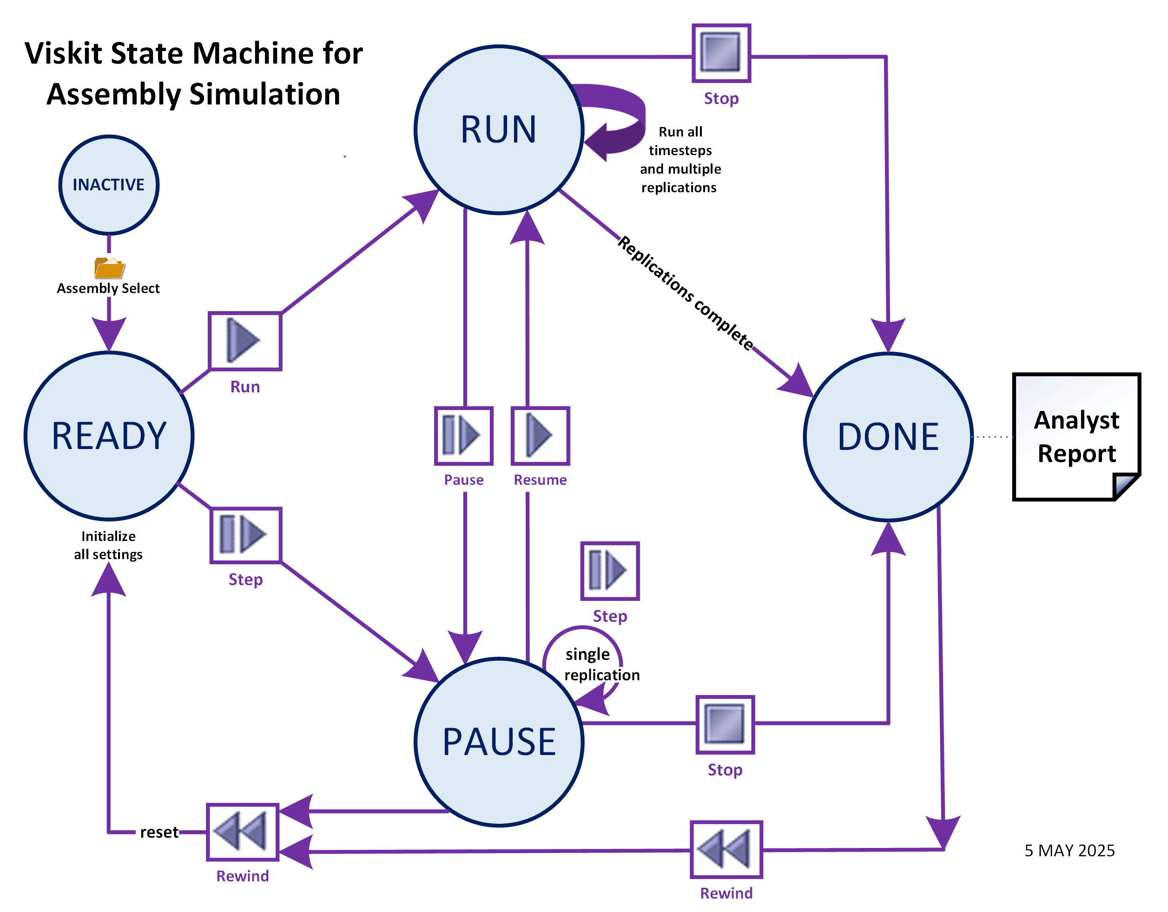
State Machine for Assembly Simulation Replications

Slide 20
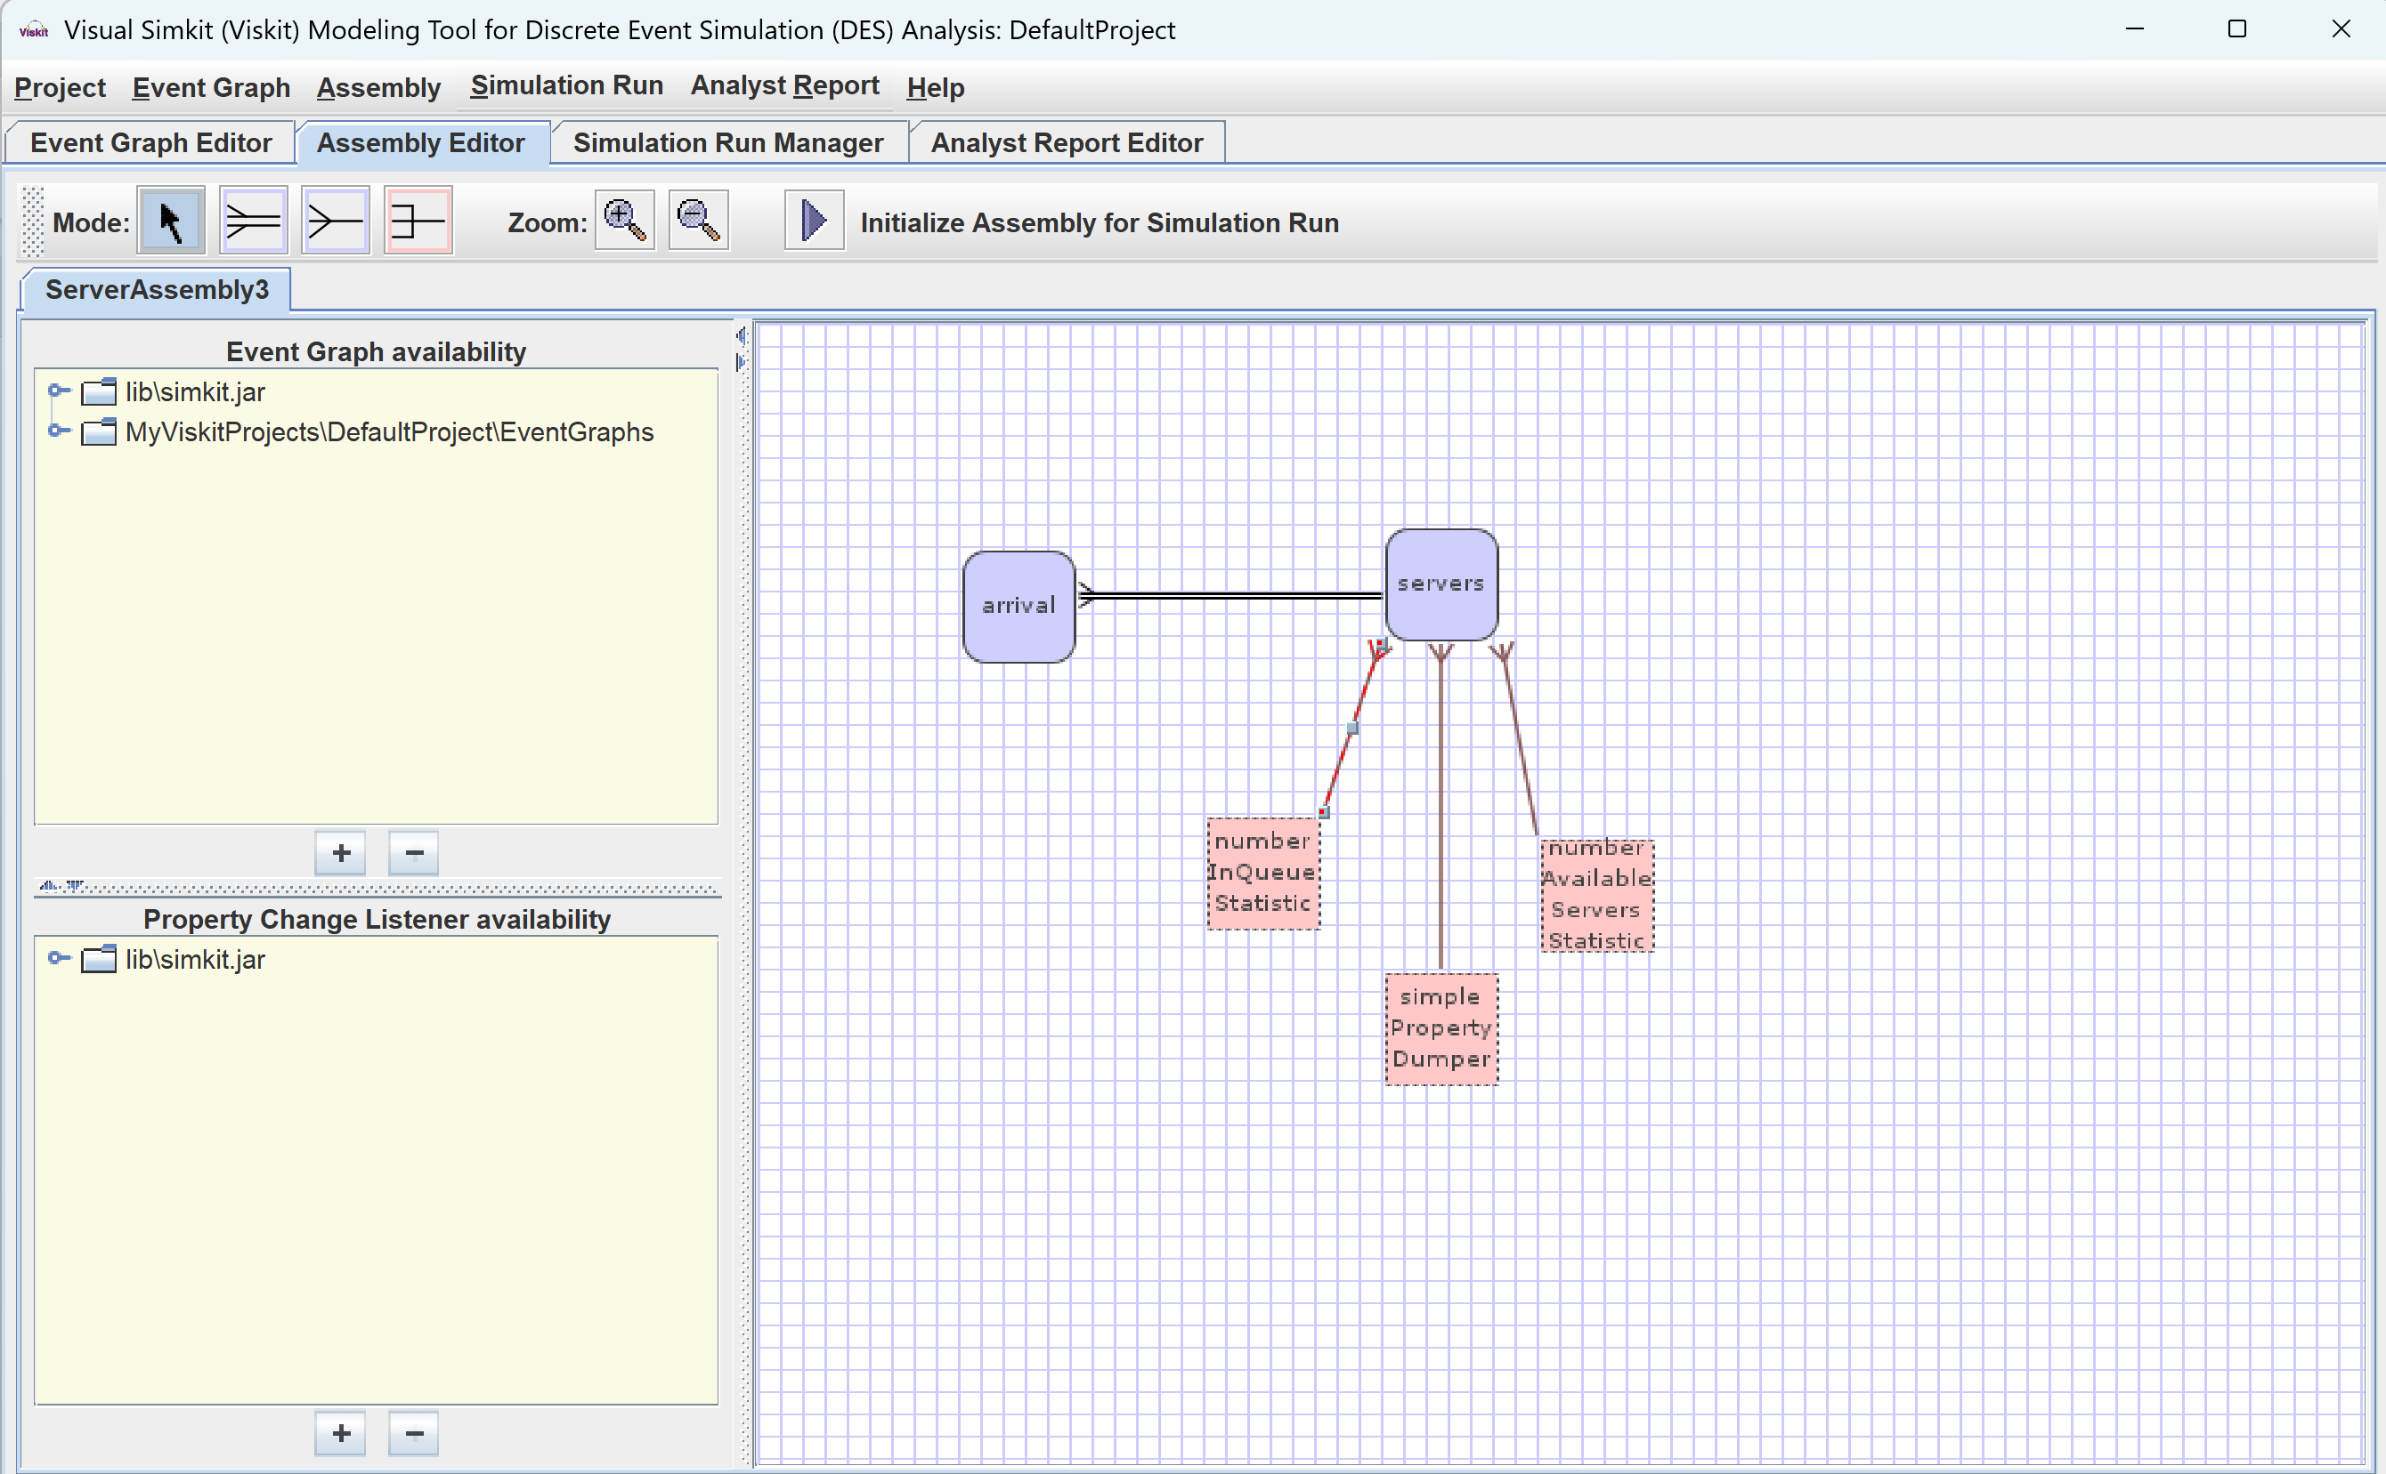
Ready to run simulations

Slide 21
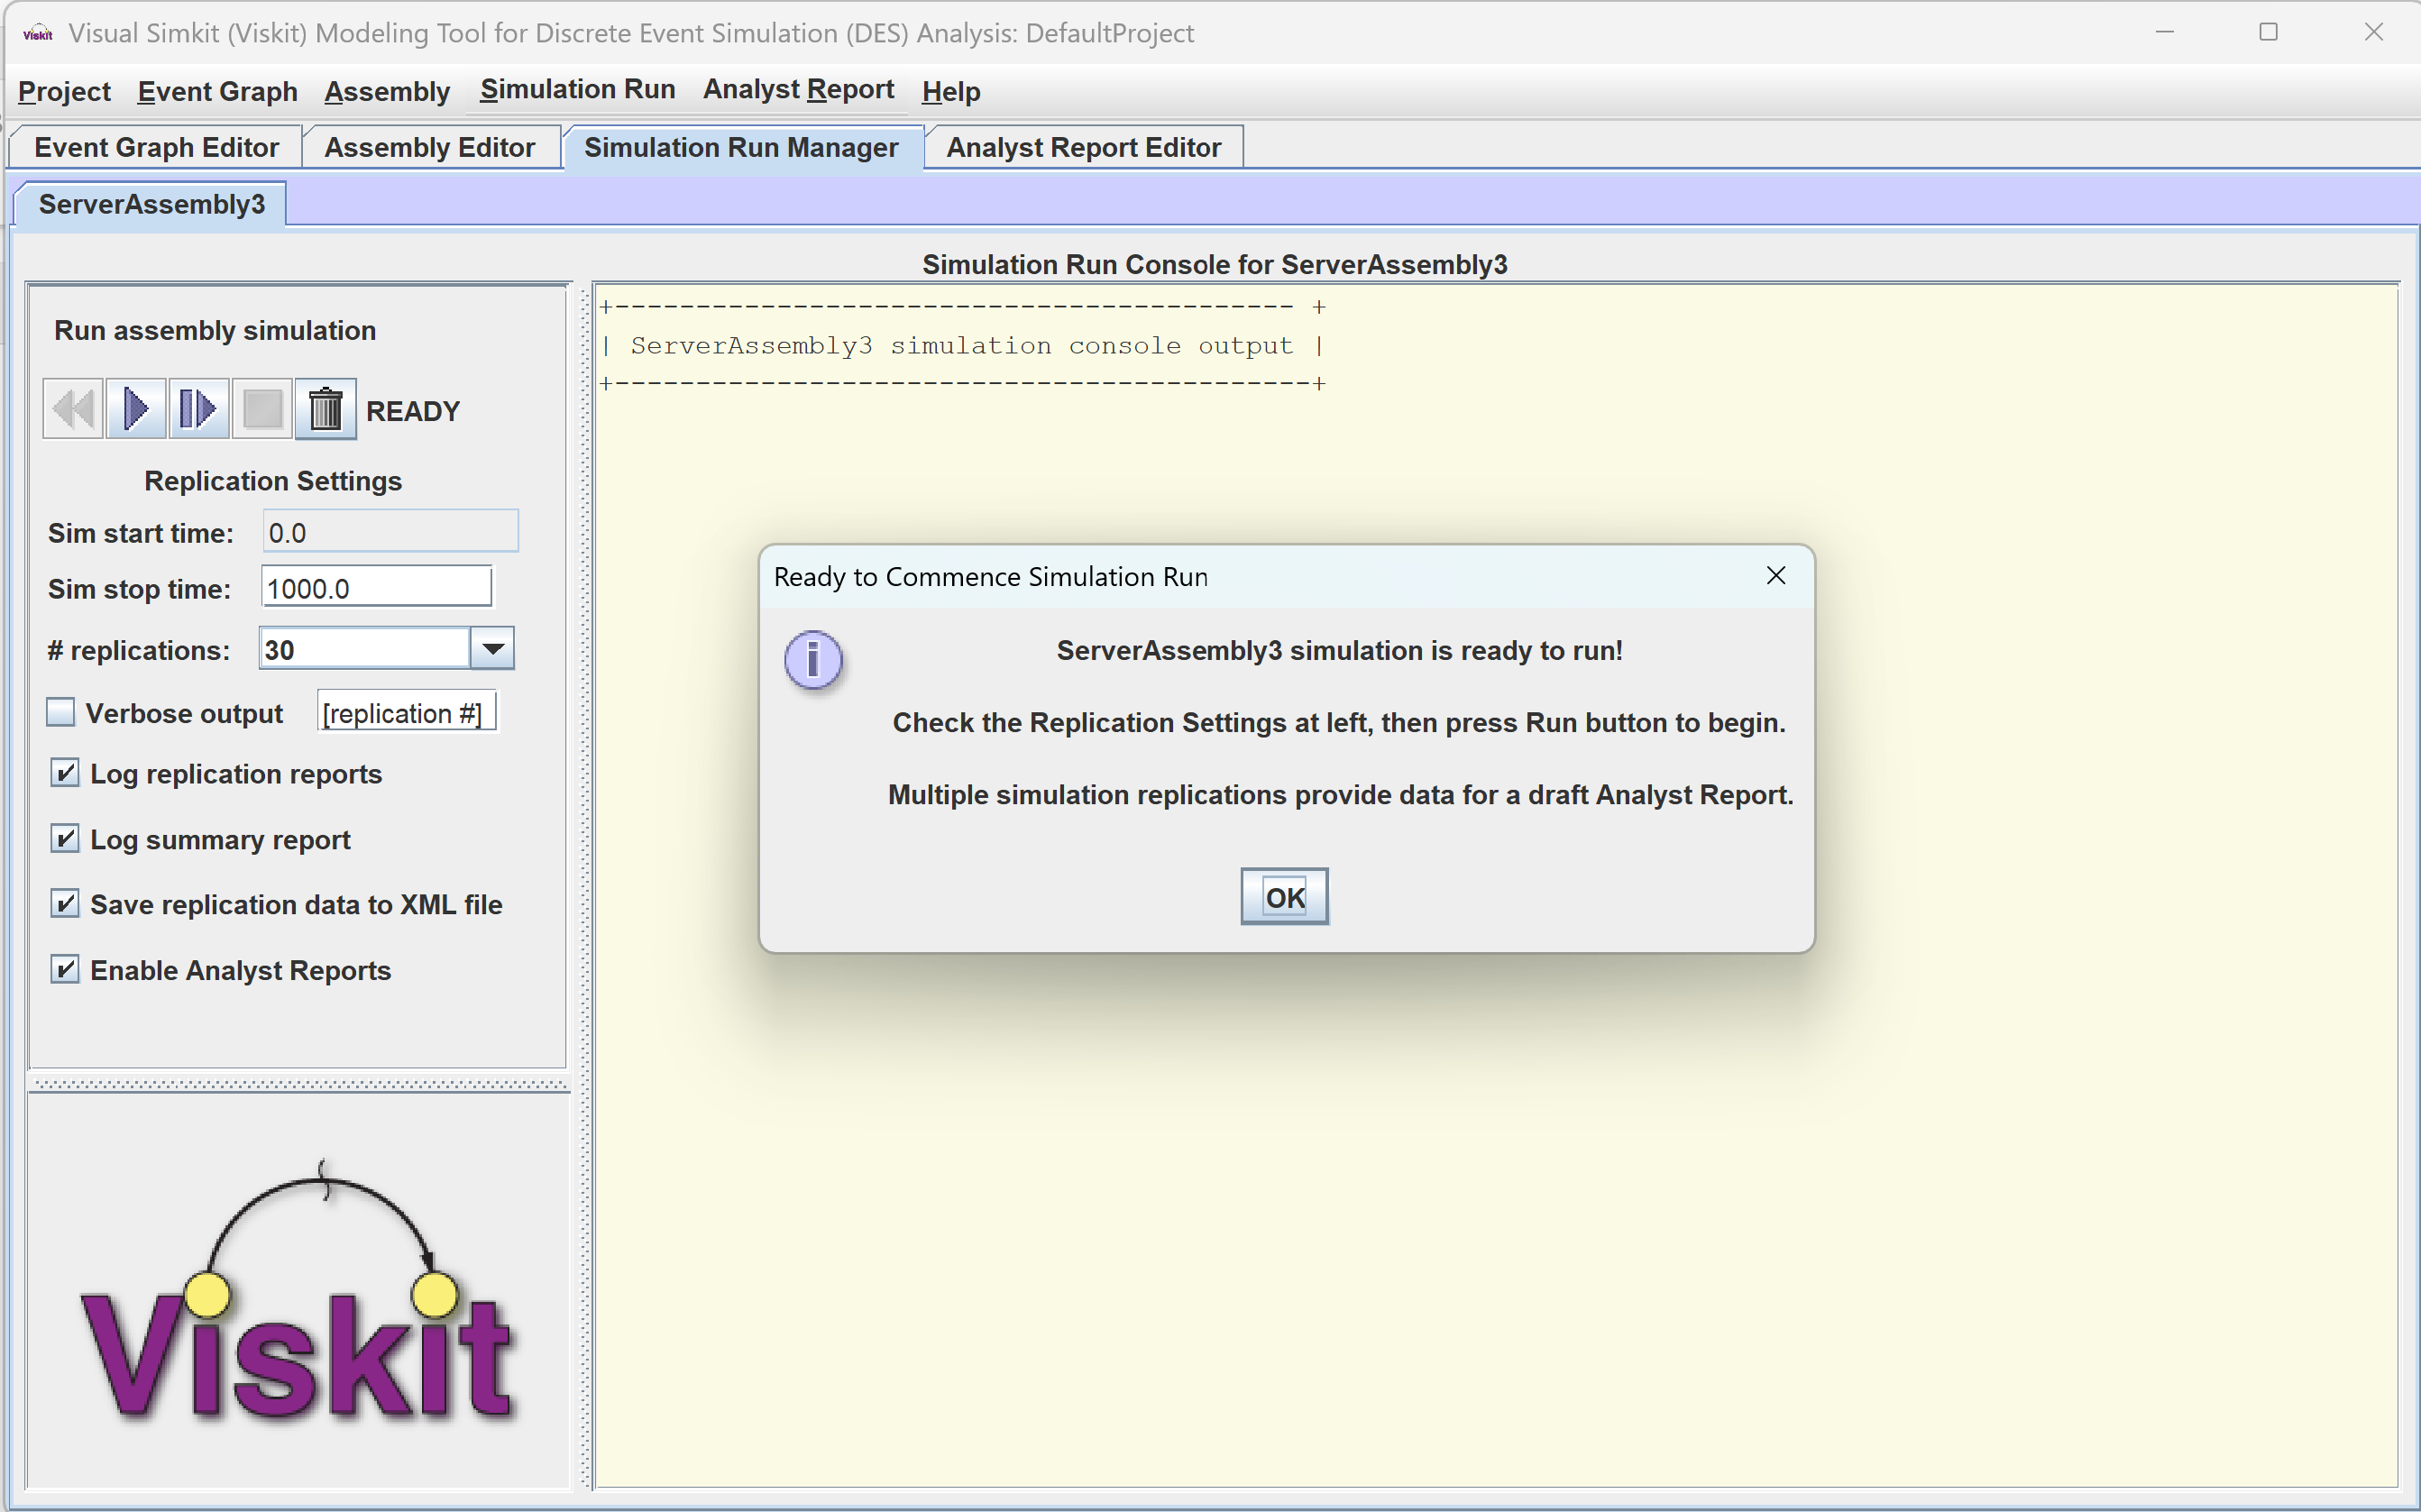
Get set to run simulations

Slide 22
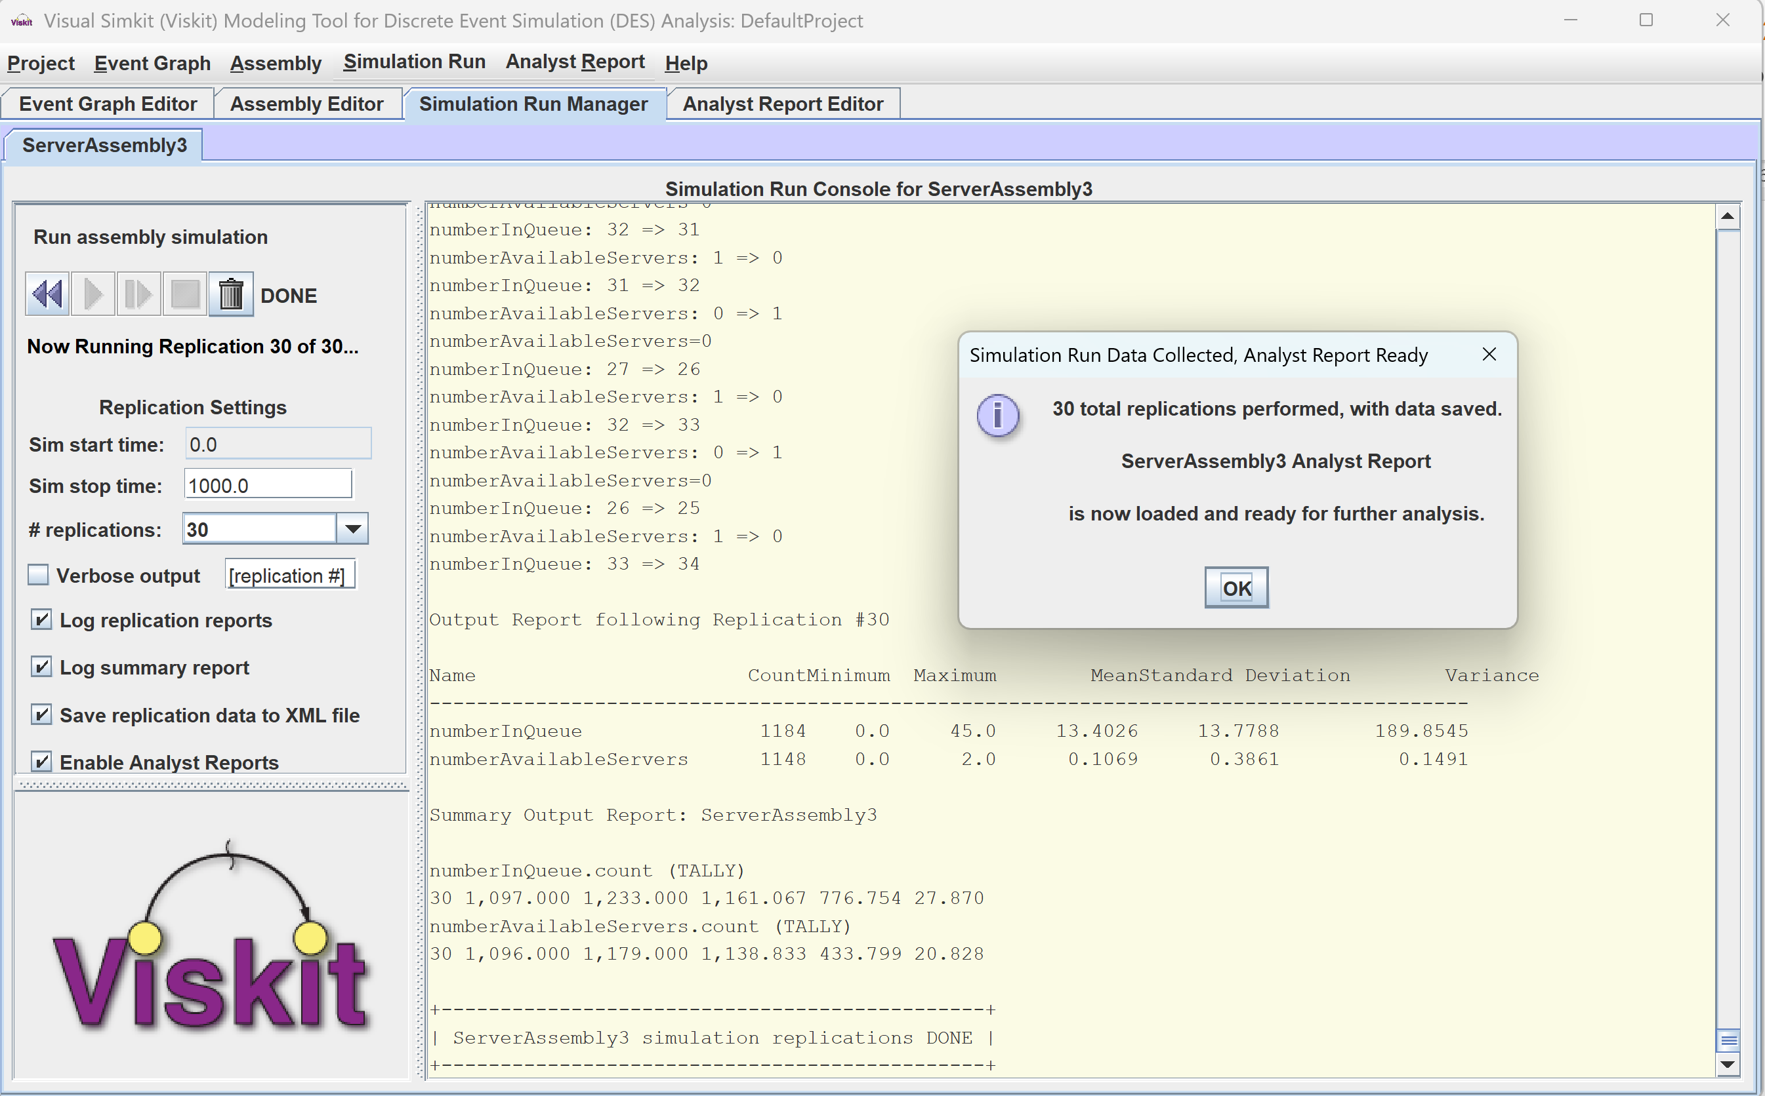
Go! Run simulations

Slide 23
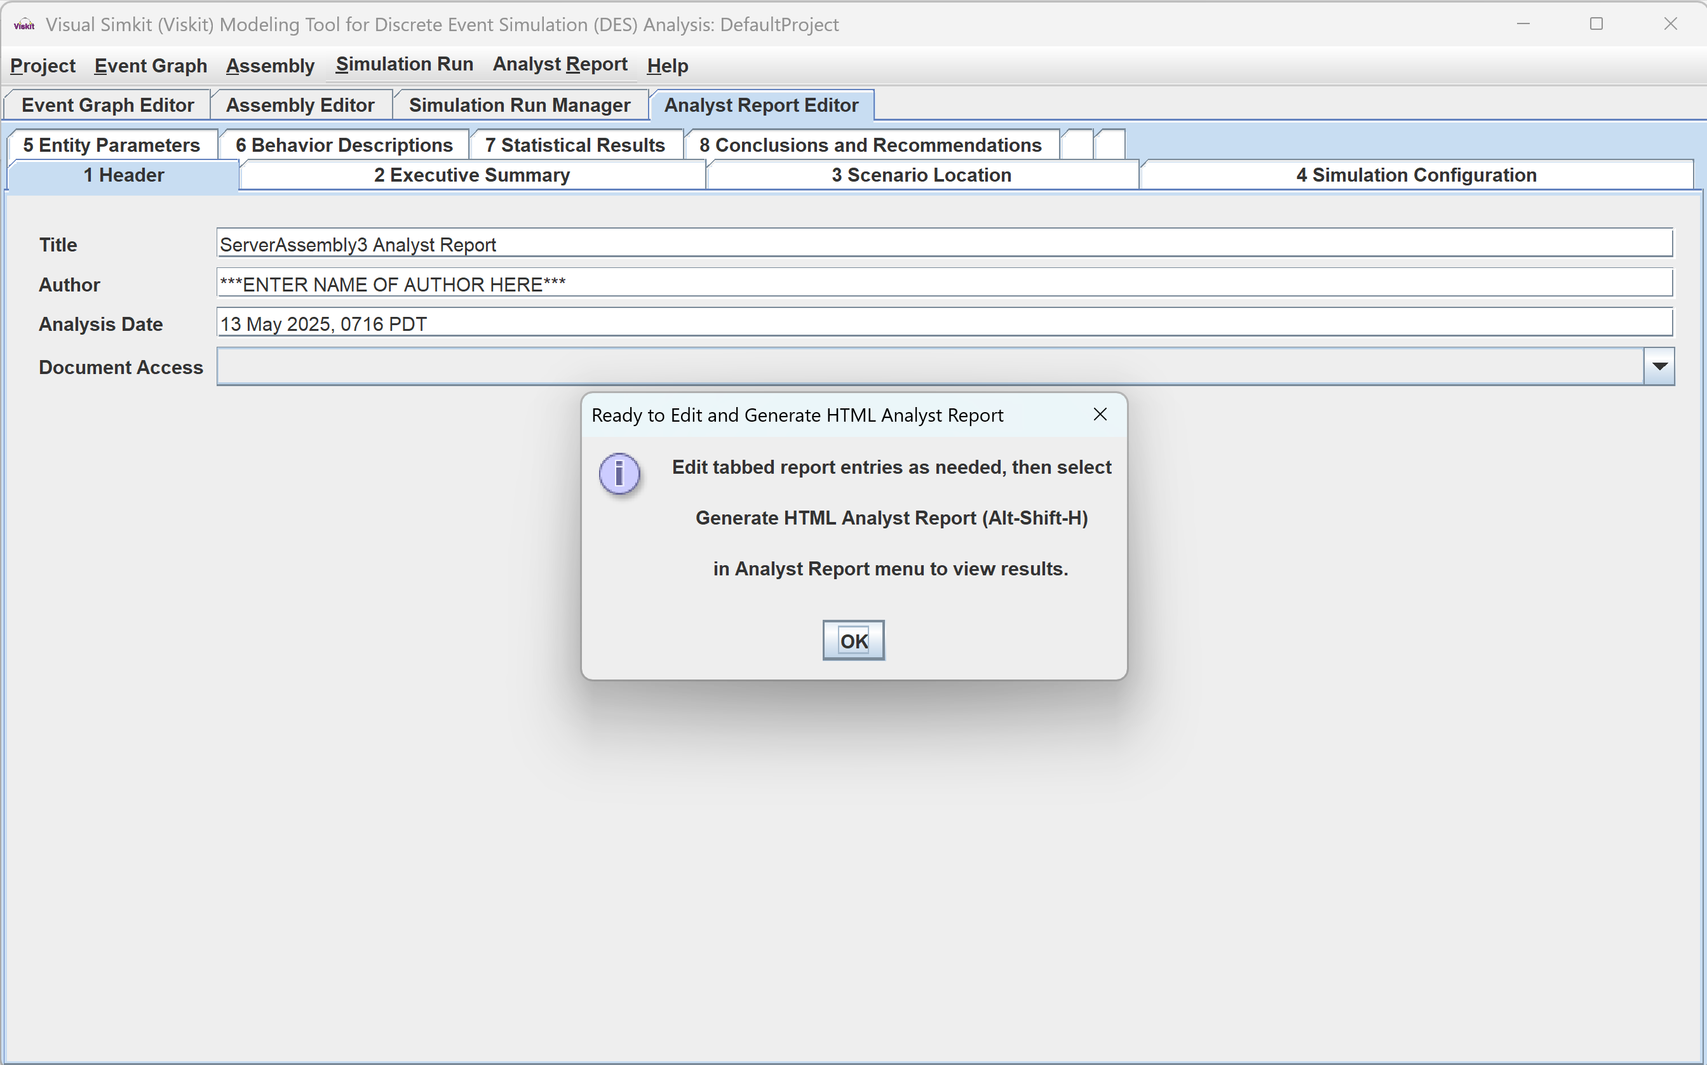
Simulation replications complete Edit Analyst Report data

Slide 24
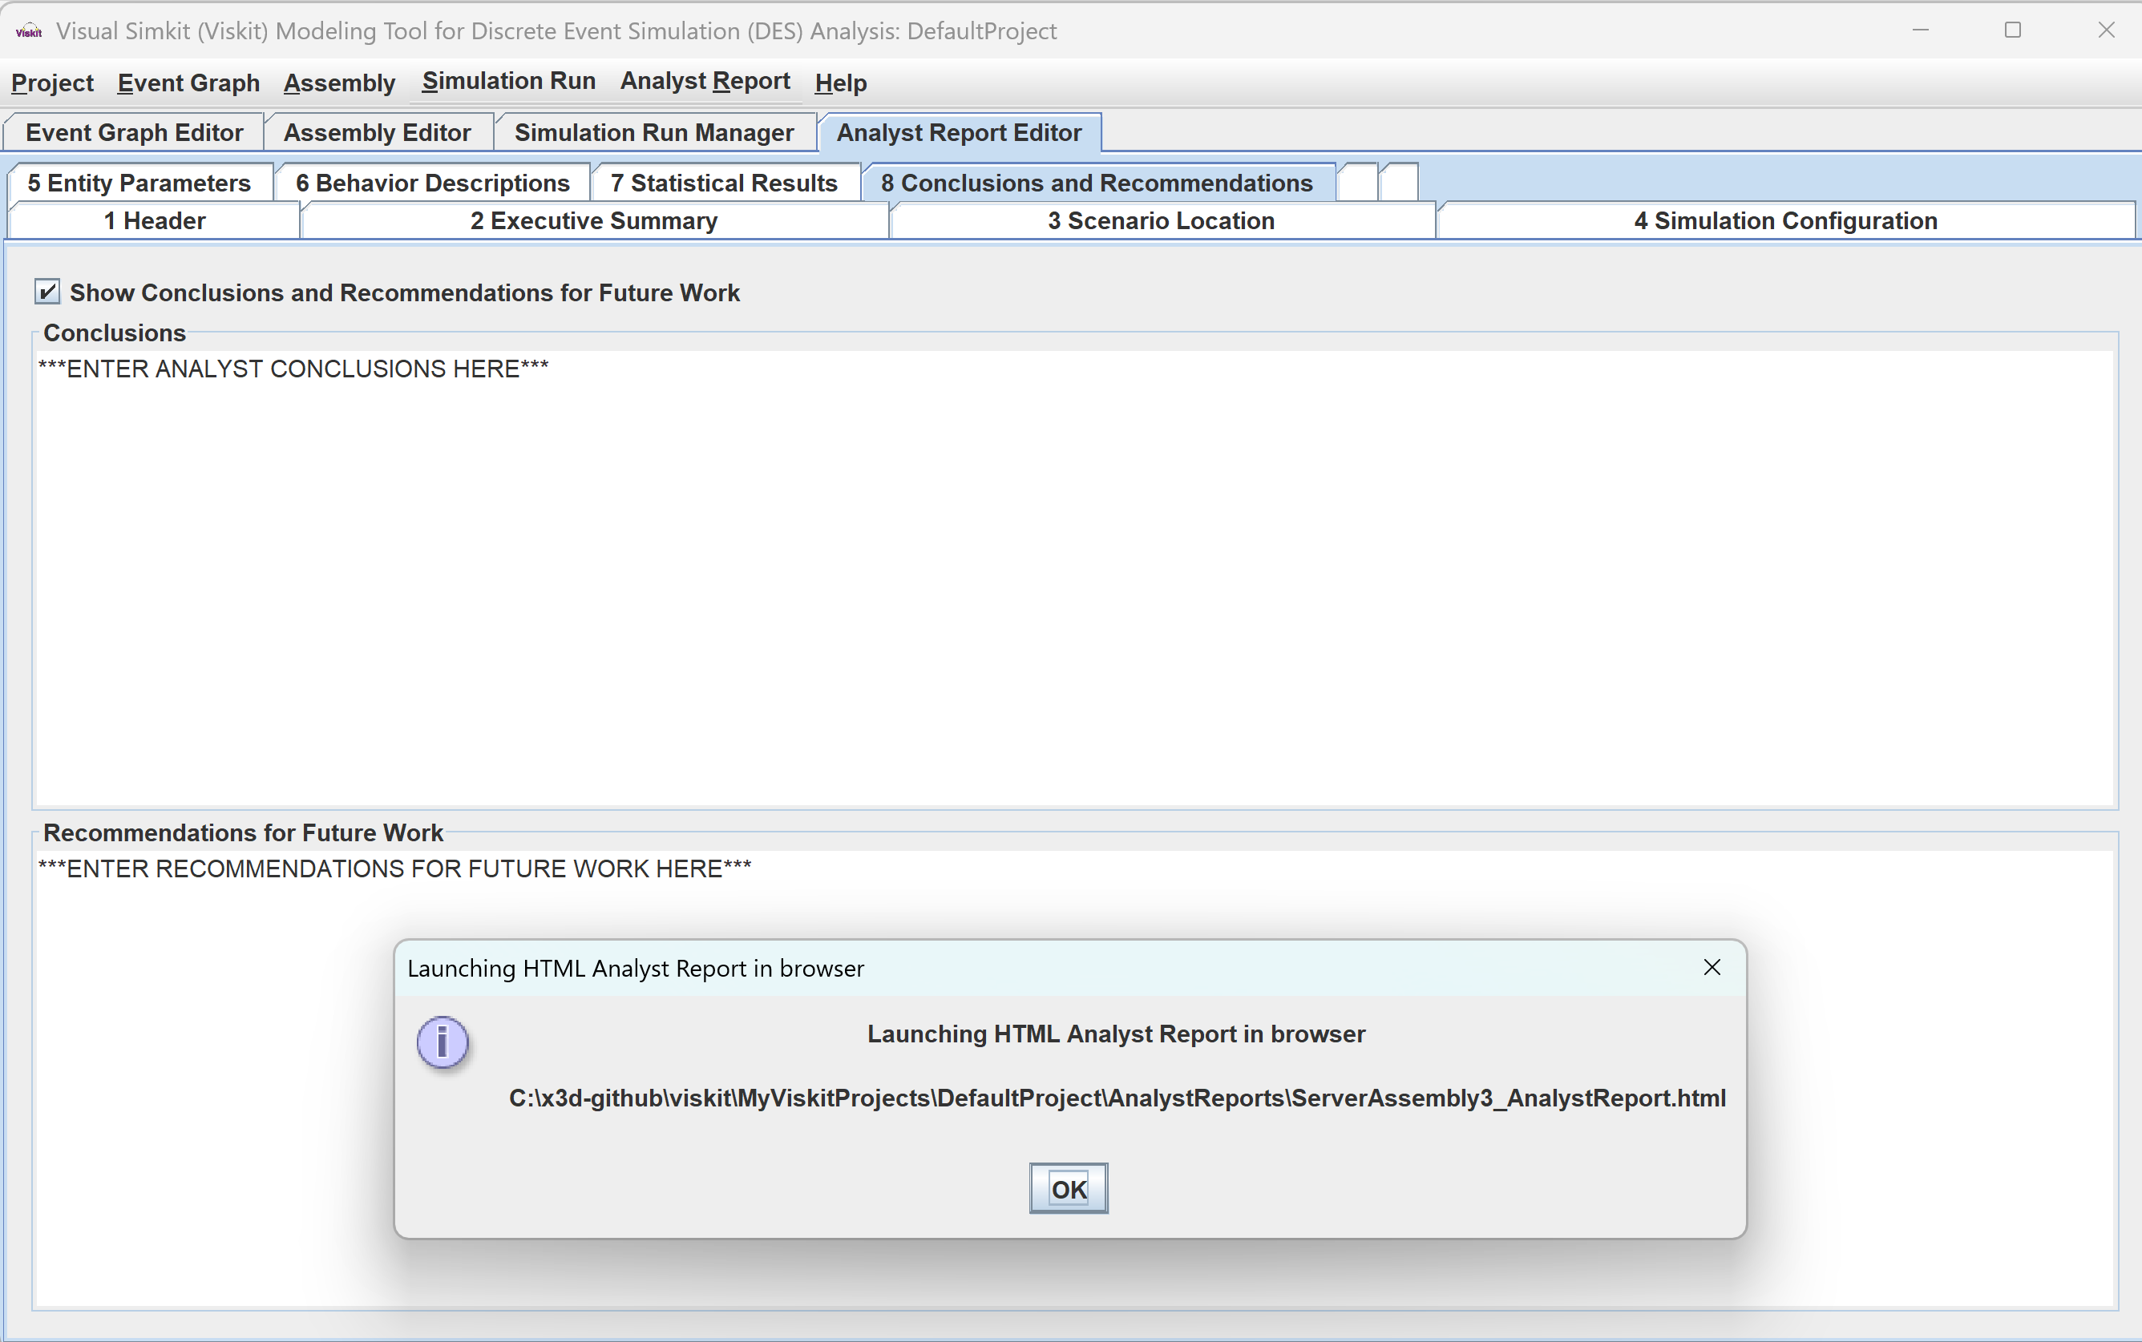
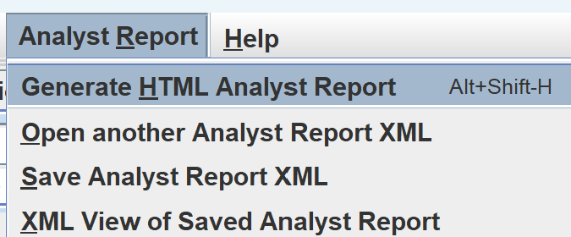
When ready, launch HTML Analyst Report in browser

Slide 25
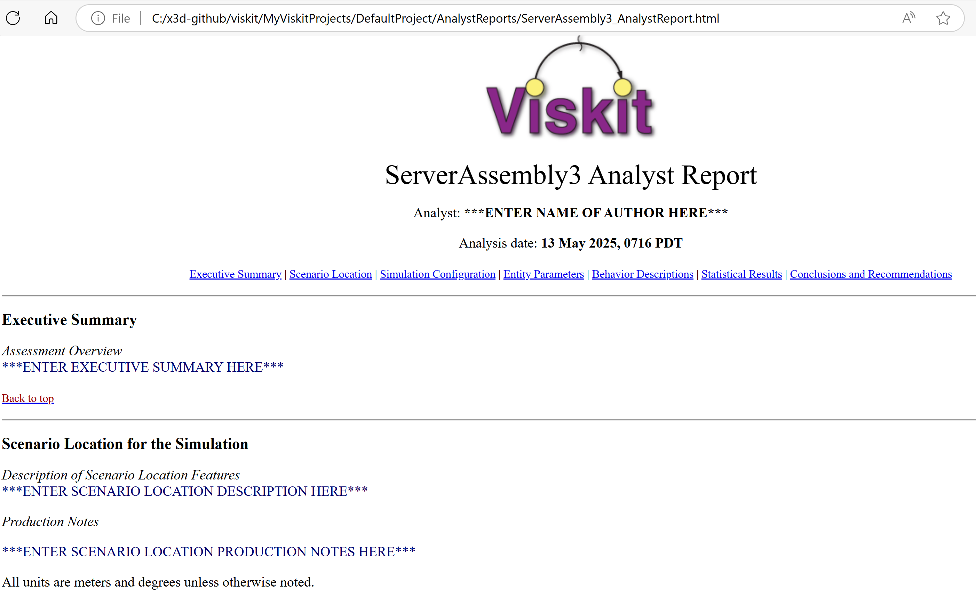
Analyst Report 1

Slide 26
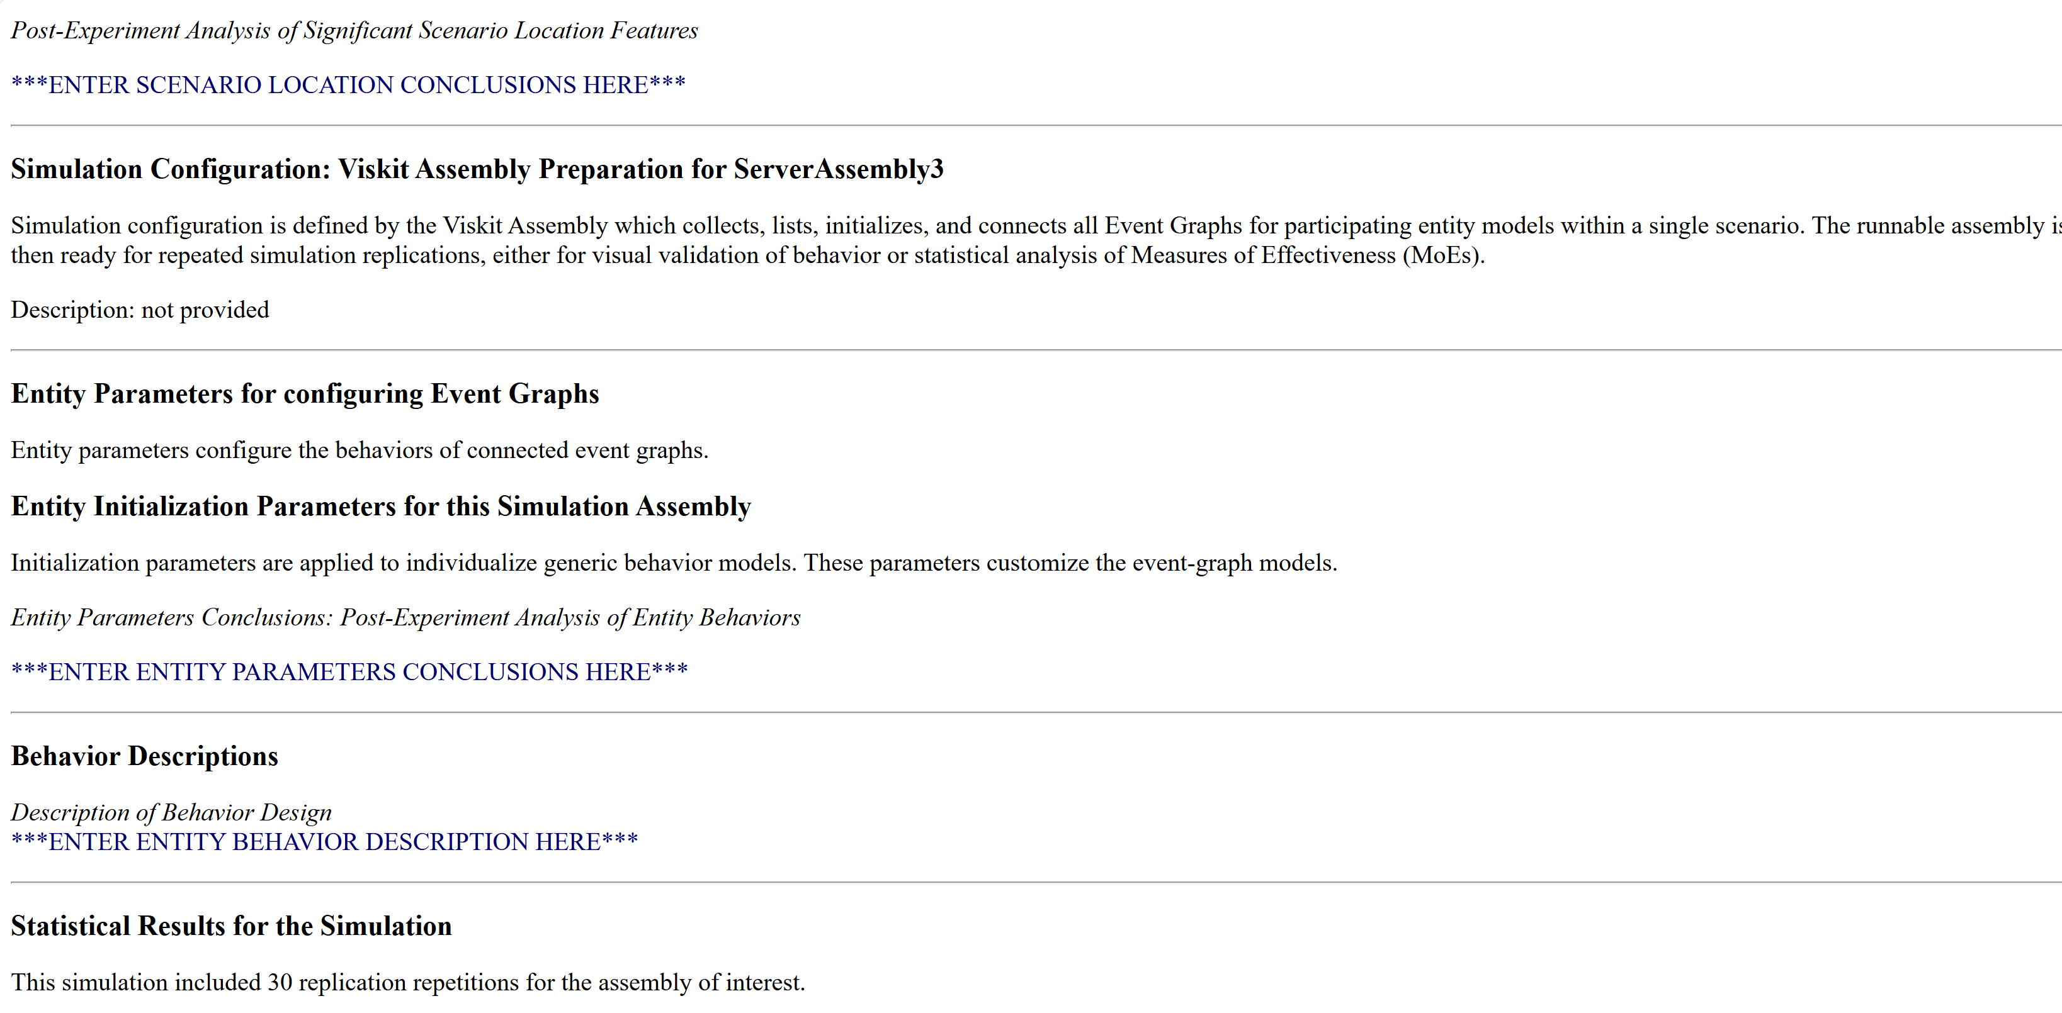
Analyst Report 2

Slide 27
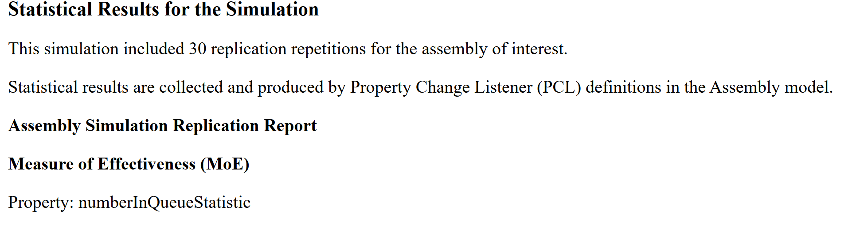
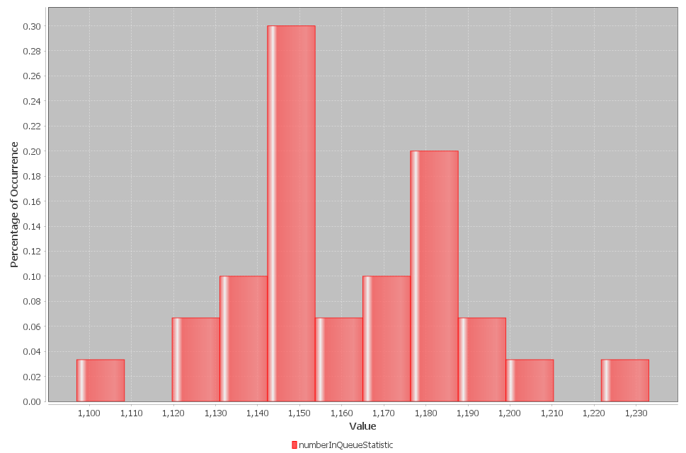
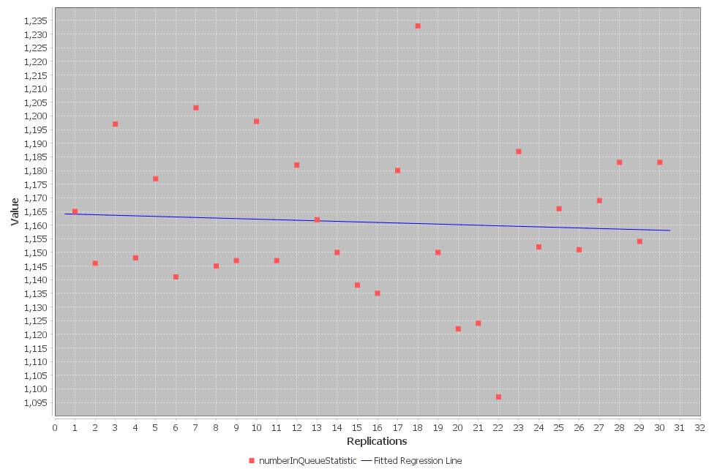
Analyst Report 3

Slide 28
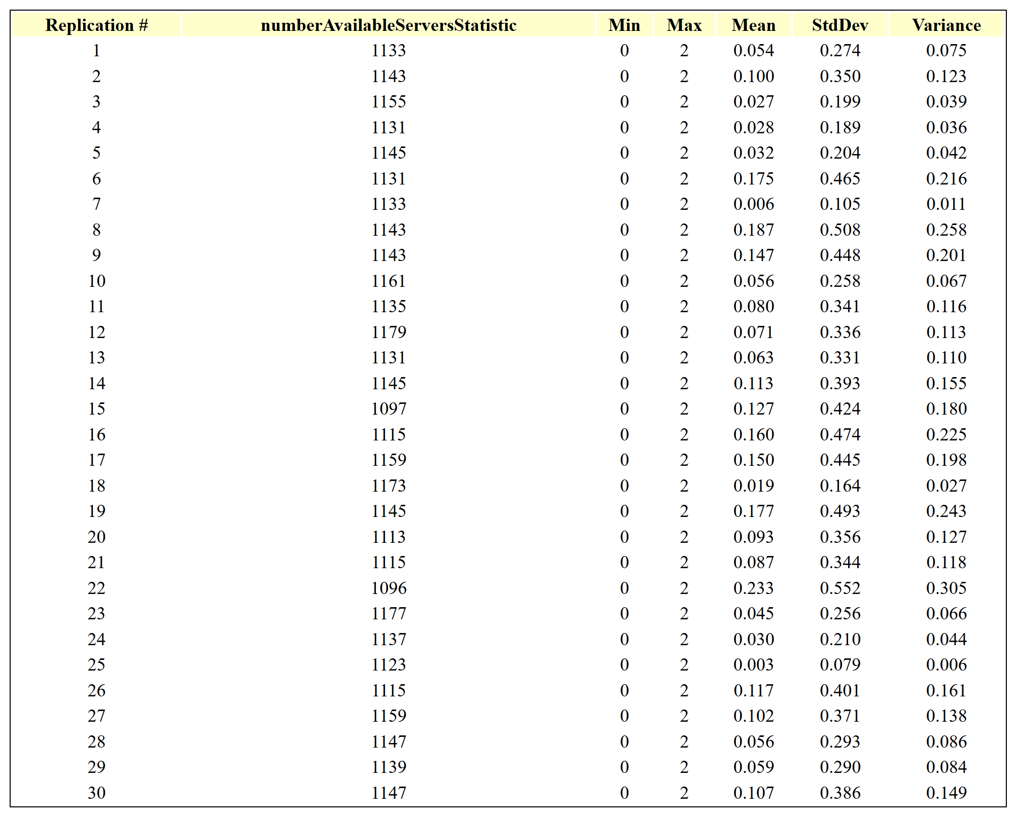
Analyst Report 4

Slide 29
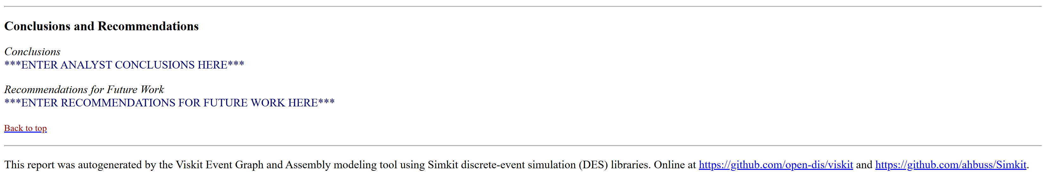
Analyst Report Completion
Thus well suited for iterative analysis and experimentation
Report files can be saved and reopened as needed – archival.
Improvements ongoing and suggestions always welcome

Slide 30
Infrastructure

Slide 31
Open-source license
Copyright (c) 1995-2025 held by the author(s). All rights reserved.
Redistribution and use in source and binary forms, with or without modification, are permitted provided that the following conditions are met:
Redistributions of source code must retain the above copyright notice, this list of conditions and the following disclaimer.
Redistributions in binary form must reproduce the above copyright notice, this list of conditions and the following disclaimer in the documentation and/or other materials provided with the distribution.
Neither the names of the Naval Postgraduate School (NPS) Modeling Virtual Environments and Simulation (MOVES) Institute nor the names of its contributors may be used to endorse or promote products derived from this software without specific prior written permission.
THIS SOFTWARE IS PROVIDED BY THE COPYRIGHT HOLDERS AND CONTRIBUTORS "AS IS" AND ANY EXPRESS OR IMPLIED WARRANTIES, INCLUDING, BUT NOT LIMITED TO, THE IMPLIED WARRANTIES OF MERCHANTABILITY AND FITNESS FOR A PARTICULAR PURPOSE ARE DISCLAIMED. IN NO EVENT SHALL THE COPYRIGHT OWNER OR CONTRIBUTORS BE LIABLE FOR ANY DIRECT, INDIRECT, INCIDENTAL, SPECIAL, EXEMPLARY, OR CONSEQUENTIAL DAMAGES (INCLUDING, BUT NOT LIMITED TO, PROCUREMENT OF SUBSTITUTE GOODS OR SERVICES; LOSS OF USE, DATA, OR PROFITS; OR BUSINESS INTERRUPTION) HOWEVER CAUSED AND ON ANY THEORY OF LIABILITY, WHETHER IN CONTRACT, STRICT LIABILITY, OR TORT (INCLUDING NEGLIGENCE OR OTHERWISE) ARISING IN ANY WAY OUT OF THE USE OF THIS SOFTWARE, EVEN IF ADVISED OF THE POSSIBILITY OF SUCH DAMAGE.

Slide 32
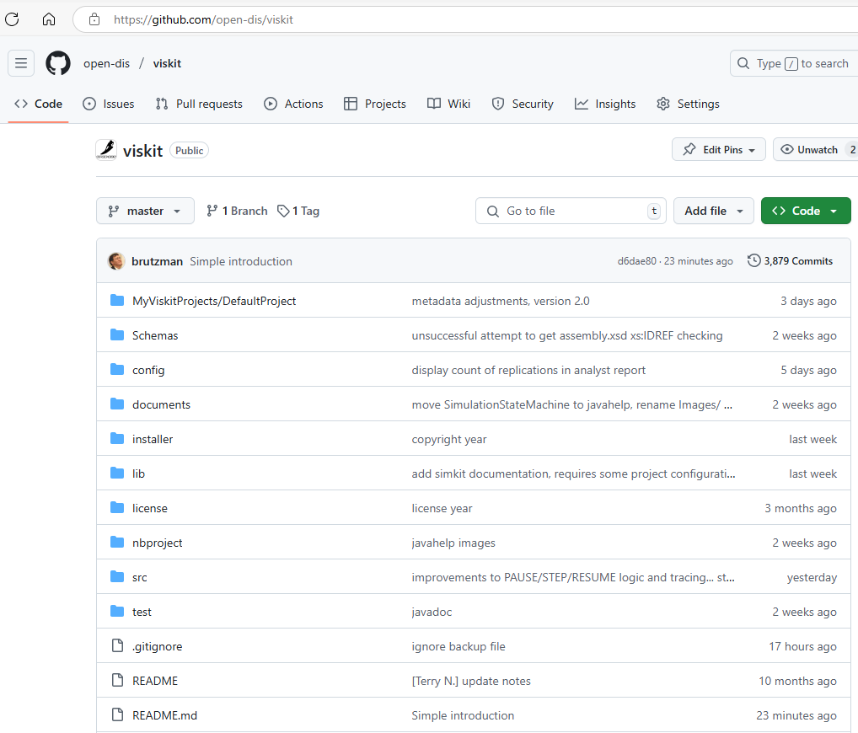
Open-source repository has moved to github https://github.com/open-dis/viskit
Previously hosted at https://gitlab.nps.edu/Savage/viskit to all NPS personnel
(U.S. and international)
Inclusion under open-dis project will hopefully encourage greater use and contributions

Slide 33
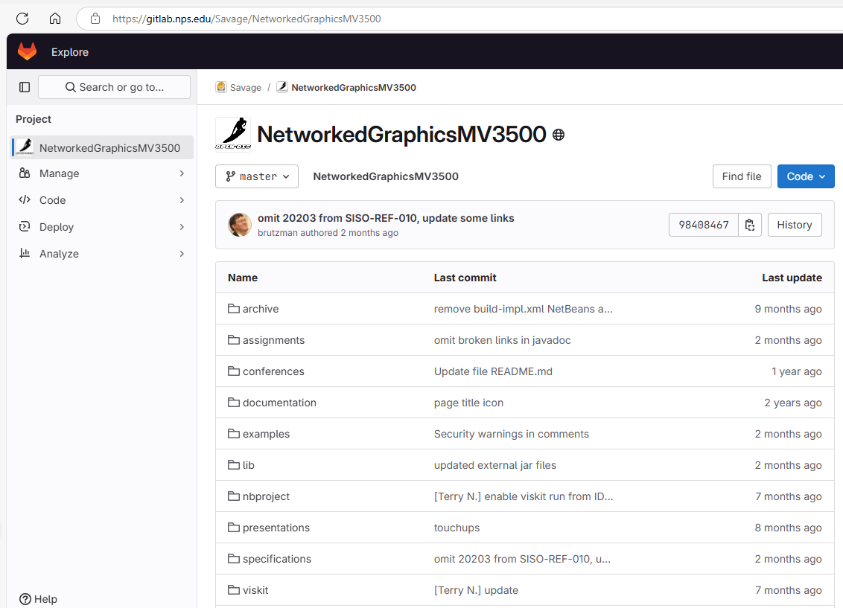
MV3500 Networked Graphics for Simulation https://gitlab.nps.edu/Savage/NetworkedGraphicsMV3500
Course slidesets and examples soon to migrate to github as well

Slide 34
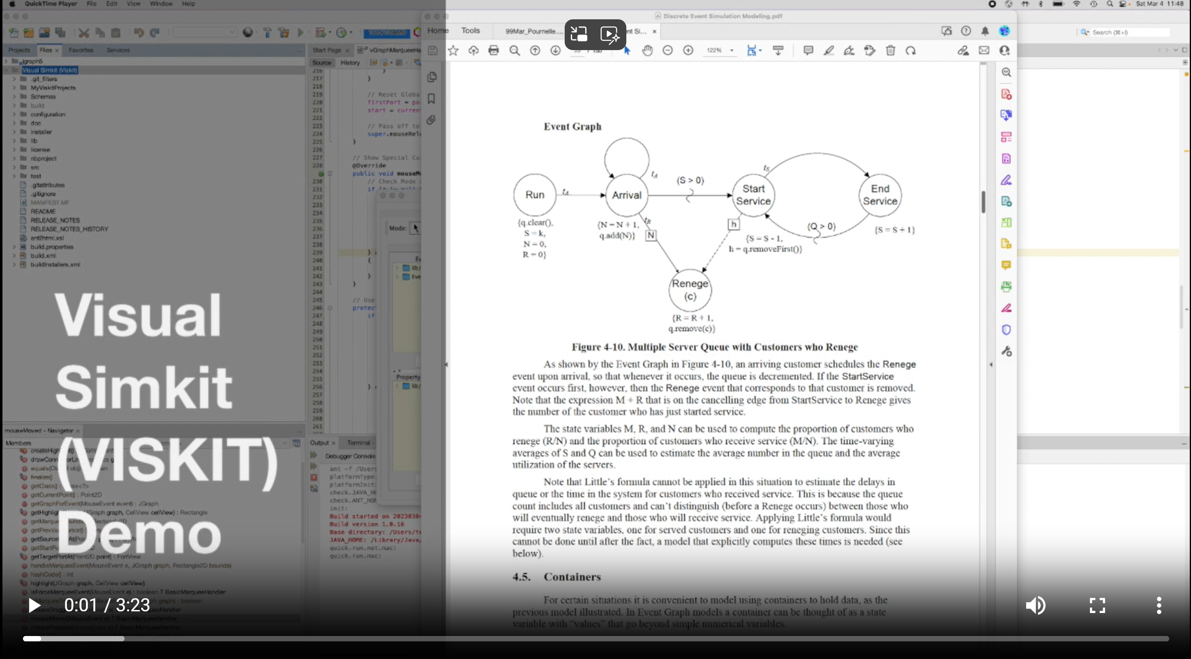
Viskit demo video https://savage.nps.edu/Savage/videos/Viskit-demo-2023MAR4.mp4

Slide 35
Contact
Don Brutzman
brutzman@nps.edu and don.brutzman@gmail.com
Terry Norbraten
tdnorbraten@nps.edu and terry.norbraten@gmail.com

